Slide 1
Welcome!
North End Boulevard (Route 1A) Reconstruction
Salisbury, MA | 607710
PUBLIC MEETING
SALISBURY, MA
AUGUST 19 | 6:30 PM

Slide 2
Introduction
North End Boulevard Reconstruction
Salisbury, MA | 607710
Introduction
Neil Harrington – Town Manager and Facilitator
Lisa Pearson – Town Planner
Frank Suszynski, P.E. - MassDOT District 4 Project Development Engineer
Patrick Crowley, P.E. – Jacobs Project Manager

Slide 3
Project Team
North End Boulevard Reconstruction
Salisbury, MA | 607710
Town of Salisbury
Project Proponent
MassDOT District 4
Project Proponent and Responsible for Administering the Design Process
Jacobs Engineering
Responsible for Design

Slide 4
Project Scope
North End Boulevard Reconstruction
Salisbury, MA | 607710
Project Scope
Reconstruction of 2 miles of North End Boulevard (Route 1A) – from Beach Road and the New Hampshire State Line
Drainage System Improvements
Inclusion of Complete Streets Elements
Intersection Design at Central Avenue
ADA Accessibility
Bicycle and Pedestrian Accommodations

Slide 5
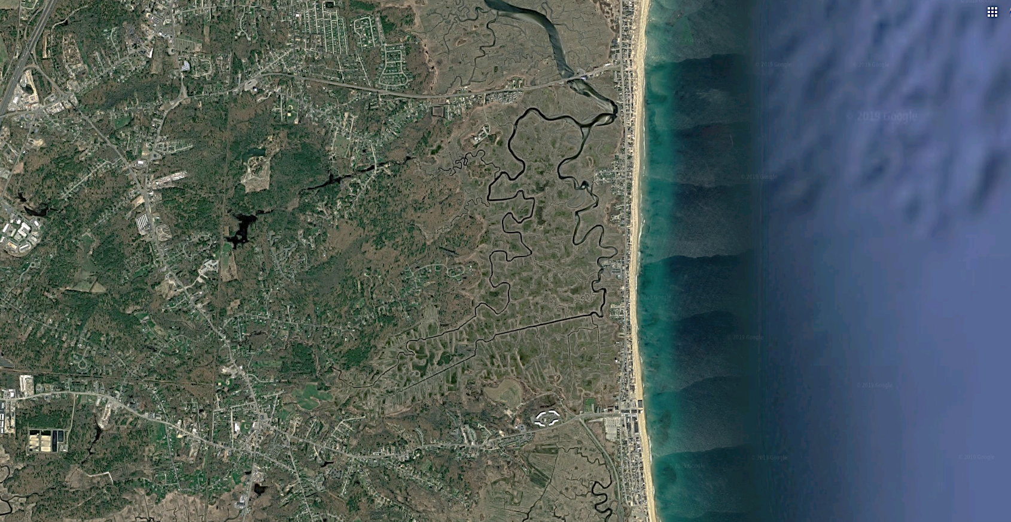
Project Area
North End Boulevard Reconstruction
Salisbury, MA | 607710
Project Area
ROUTE 286
NORTH END BOULEVARD
ROUTE 1A

Slide 6
Why do we need this project?
North End Boulevard Reconstruction
Salisbury, MA | 607710
.
Drainage Improvements
Improve Overall Roadway Safety
Complete Streets
Central Avenue Intersection

Slide 7
North End Boulevard Reconstruction
Salisbury, MA | 607710
Existing Issues
Drainage
Intersection Safety
Pavement Condition
Deficient Pedestrian Accommodation
Deficient Bicycle Accommodation

Slide 8
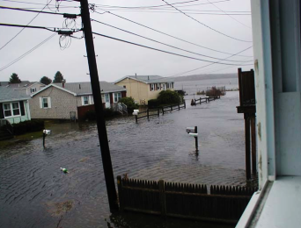
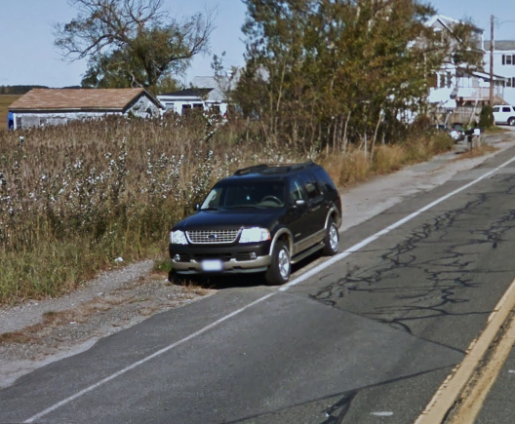
North End Boulevard Reconstruction
Salisbury, MA | 607710
Existing Issues (cont.)

Slide 9
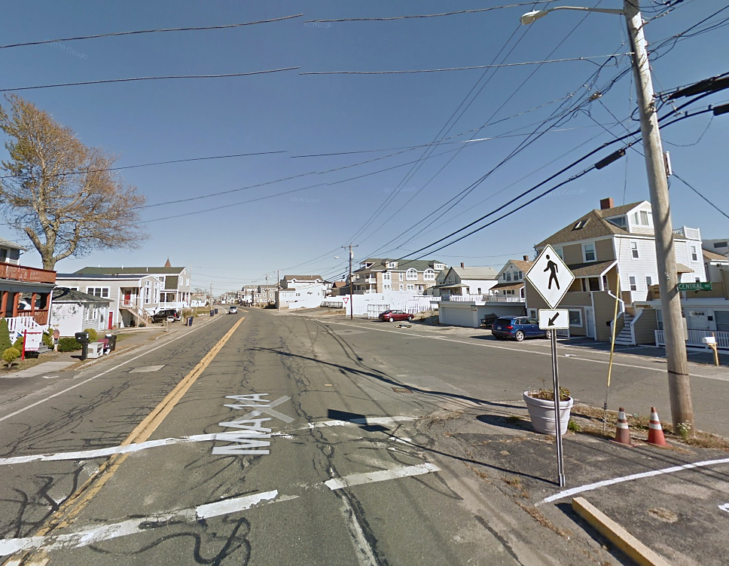
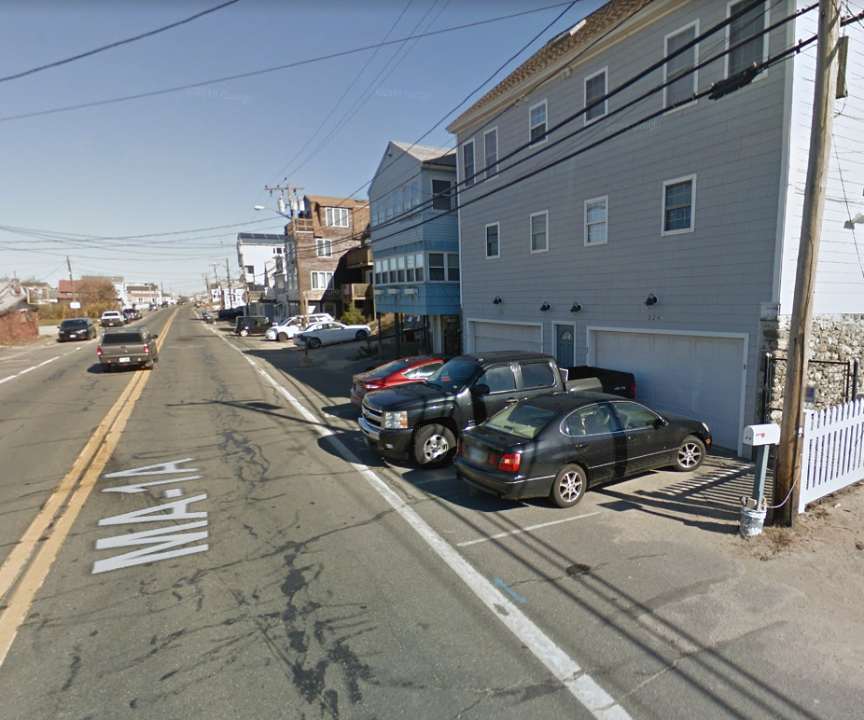
North End Boulevard Reconstruction
Salisbury, MA | 607710
Existing Issues (cont.)

Slide 10
North End Boulevard Reconstruction
Salisbury, MA | 607710
Project Goals
Drainage | Analyze Drainage System, Improve Drainage Runoff Control, Reduce Flooding
Intersection Safety | Improve Intersection Safety
Roadway Safety| Improve Overall Roadway Safety.
Deficient Pedestrian Accommodation | Improve Pedestrian Accommodations.
Deficient Bike Accommodation | Improve Bicyclist Accommodations.
Minimize Right-of-Way Impacts

Slide 11
North End Boulevard Reconstruction
Salisbury, MA | 607710
Alternatives
Concept A - Bike Lanes
Concept B - Two-Way Separated Bike Lanes
Concept C - Shared Use Path

Slide 12
North End Boulevard Reconstruction
Salisbury, MA | 607710
Alternatives
Concept A - Bike Lanes

Slide 13
North End Boulevard Reconstruction
Salisbury, MA | 607710
Alternatives
Concept A - Bike Lanes
Notes:
Insert project name, location, file no.
Depending on complexity, may need to be multiple slides;

Slide 14
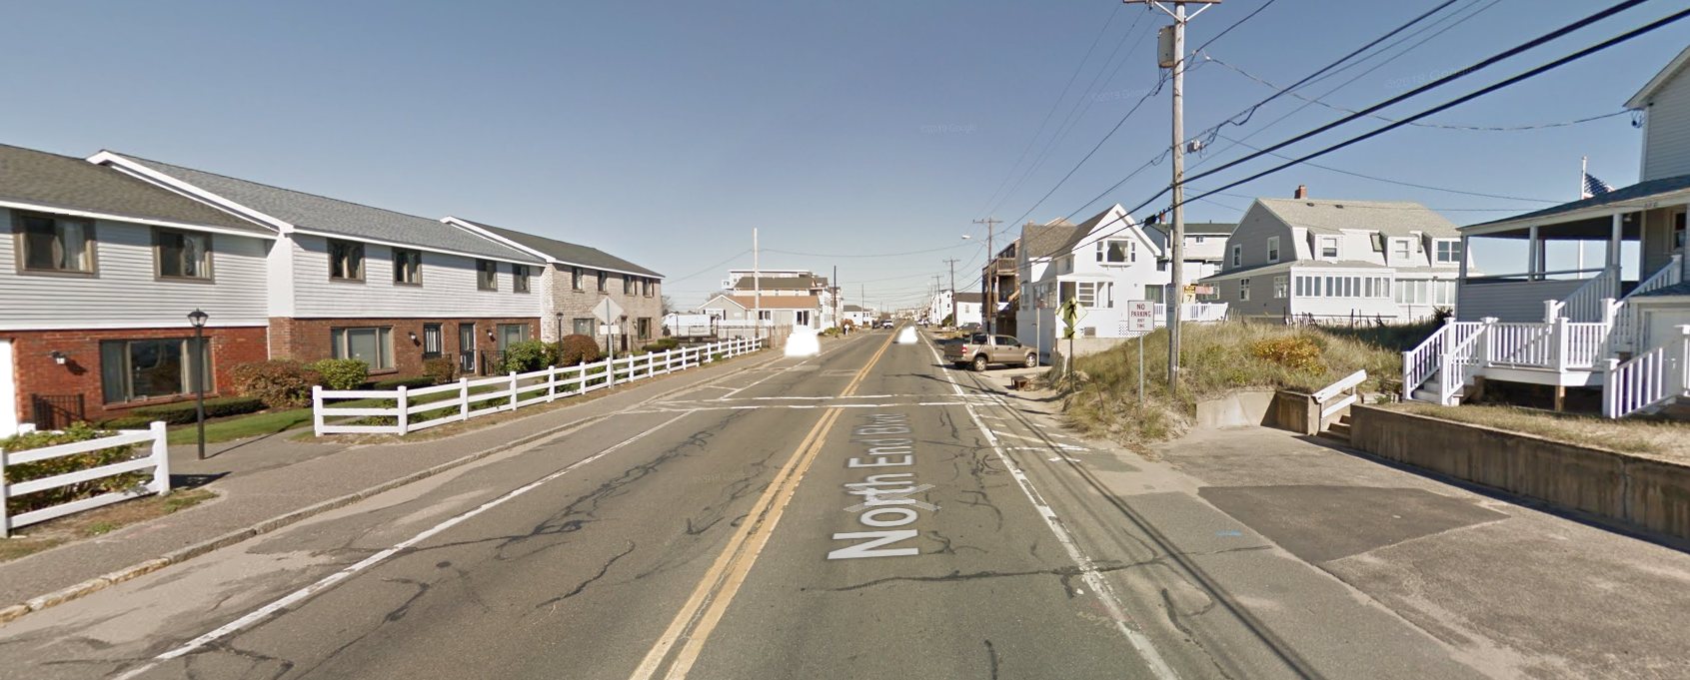
North End Boulevard Reconstruction
Salisbury, MA | 607710
Alternatives
Concept A - Bike Lanes
Notes:
Insert project name, location, file no.
Depending on complexity, may need to be multiple slides;

Slide 15
North End Boulevard Reconstruction
Salisbury, MA | 607710
Alternatives
Concept A - Bike Lanes

Slide 16
North End Boulevard Reconstruction
Salisbury, MA | 607710
Alternatives
Concept A - Bike Lanes
Notes:
Insert project name, location, file no.
Depending on complexity, may need to be multiple slides;

Slide 17
North End Boulevard Reconstruction
Salisbury, MA | 607710
Alternatives
Concept A - Bike Lanes
Notes:
Insert project name, location, file no.
Depending on complexity, may need to be multiple slides;

Slide 18
North End Boulevard Reconstruction
Salisbury, MA | 607710
Alternatives
Concept A - Bike Lanes
Notes:
Insert project name, location, file no.
Depending on complexity, may need to be multiple slides;

Slide 19
North End Boulevard Reconstruction
Salisbury, MA | 607710
Alternatives
Concept B - Two-Way Separated Bike Lanes
Notes:
Insert project name, location, file no.
Depending on complexity, may need to be multiple slides;

Slide 20
North End Boulevard Reconstruction
Salisbury, MA | 607710
Alternatives
Concept B – Two-Way Separated Bike Lanes
Notes:
Insert project name, location, file no.
Depending on complexity, may need to be multiple slides;

Slide 21
North End Boulevard Reconstruction
Salisbury, MA | 607710
Alternatives
Concept B – Two-Way Separated Bike Lanes
Notes:
Insert project name, location, file no.
Depending on complexity, may need to be multiple slides;

Slide 22
North End Boulevard Reconstruction
Salisbury, MA | 607710
Alternatives
Concept B – Two-Way Separated Bike Lanes
Notes:
Insert project name, location, file no.
Depending on complexity, may need to be multiple slides;

Slide 23
North End Boulevard Reconstruction
Salisbury, MA | 607710
Alternatives
Concept B – Two-Way Separated Bike Lanes
Notes:
Insert project name, location, file no.
Depending on complexity, may need to be multiple slides;

Slide 24
North End Boulevard Reconstruction
Salisbury, MA | 607710
Alternatives
Concept B – Two-Way Separated Bike Lanes
Notes:
Insert project name, location, file no.
Depending on complexity, may need to be multiple slides;

Slide 25
North End Boulevard Reconstruction
Salisbury, MA | 607710
Alternatives
Concept C - Shared Use Path
Notes:
Insert project name, location, file no.
Depending on complexity, may need to be multiple slides;

Slide 26
North End Boulevard Reconstruction
Salisbury, MA | 607710
Alternatives
Concept C – Shared Use Path
Notes:
Insert project name, location, file no.
Depending on complexity, may need to be multiple slides;

Slide 27
North End Boulevard Reconstruction
Salisbury, MA | 607710
Alternatives
Concept C – Shared Use Path
Notes:
Insert project name, location, file no.
Depending on complexity, may need to be multiple slides;

Slide 28
North End Boulevard Reconstruction
Salisbury, MA | 607710
Alternatives
Concept C – Shared Use Path
Notes:
Insert project name, location, file no.
Depending on complexity, may need to be multiple slides;

Slide 29
North End Boulevard Reconstruction
Salisbury, MA | 607710
Alternatives
Concept C – Shared Use Path
Notes:
Insert project name, location, file no.
Depending on complexity, may need to be multiple slides;

Slide 30
North End Boulevard Reconstruction
Salisbury, MA | 607710
Alternatives
Concept C – Shared Use Path
Notes:
Insert project name, location, file no.
Depending on complexity, may need to be multiple slides;

Slide 31
Next Steps/Meeting
North End Boulevard Reconstruction
Salisbury, MA | 607710
.
Continue with Drainage Assessment.
Base Survey Mapping.
Right-of-Way Assessment.
Notes:
Insert project name, location, file no.
List the next meeting info

Slide 32
North End Boulevard Reconstruction
Salisbury, MA | 607710
Contact Information
Provide:
Mail-in comment sheets
Frank Suszynski, P.E. - District 4 Project Development Engineer
Email: Frank.Suszynski@state.ma.us
Phone: 781-641-8474
Notes:
Insert project name, location, file no.
Provide contact information

Slide 33
Thank You Q&A
North End Boulevard (Route 1A) Reconstruction
Salisbury, MA | 607710
PUBLIC MEETING
SALISBURY, MA
August 19 | 6:30PM

