Slide 2
MS4 Compliance
Town of Salisbury, MA
June 10, 2020

Slide 3
What is an MS4?
Municipal Separate Storm Sewer System (MS4) All man-made stormwater collection and conveyance infrastructure owned by a municipality.
Drain Pipes
Drain Manholes
Catch basins
Outfalls
Culverts
Man-made Channels / Swales
Infiltration / Detention / Retention Basins
Treatment structures

Slide 4
Background
Clean Water Act
National Pollutant Discharge Elimination System (NPDES) Program
Municipal Separate Storm Sewer System (MS4)
MS4 Permit Issued 2003

Slide 5
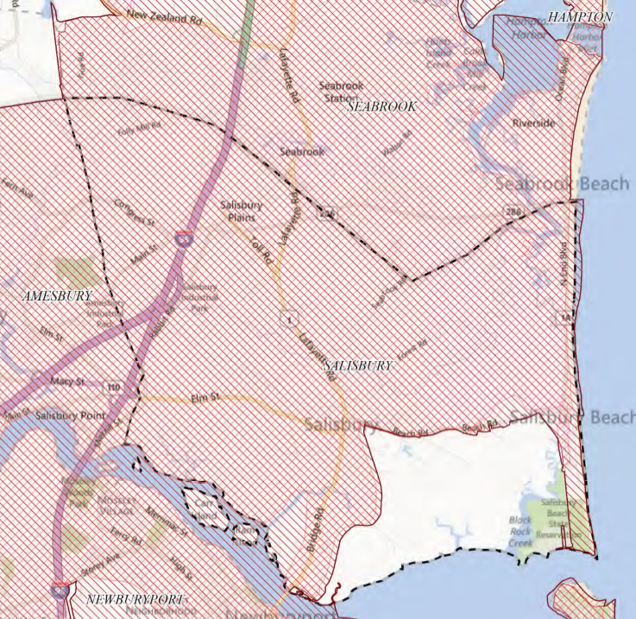
Regulated Area in Salisbury
“Urbanized Area” as defined by 2000 and 2010 Census
MS4 Discharges to “Waters of the US”

Slide 6
Background
Five-year permit cycle expired May 2008
2003 Permit “administratively continued”
2016 Permit effective July 1, 2018
Notice of Intent submitted October 1, 2018
Permit Year 2 – July 1, 2019 to June 30, 2020

Slide 7
2016 vs. 2003 MS4 Permit
Greater Accountability
More detailed requirements & stricter timeframes for Best Management Practices (BMP) implementation
More Documentation
Enhanced Reporting Requirements
More Prescriptive Requirements for Impaired Waters

Slide 8
Same 6 Minimum Control Measures
Public Education and Outreach
Public Participation and Involvement
Illicit Discharge Detection and Elimination
Construction Site Runoff Control
Post-Construction Runoff Control
Pollution Prevention/Good Housekeeping

Slide 9
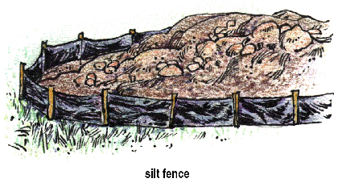
Last Year: Construction Site Runoff Control
Updated bylaws/rules and regulations to include:
Requirements for erosion and sediment control BMPs
Requirements for waste control on construction sites
Created written procedures for:
Site plan review
Site inspection and enforcement
1-Acre Threshold

Slide 10
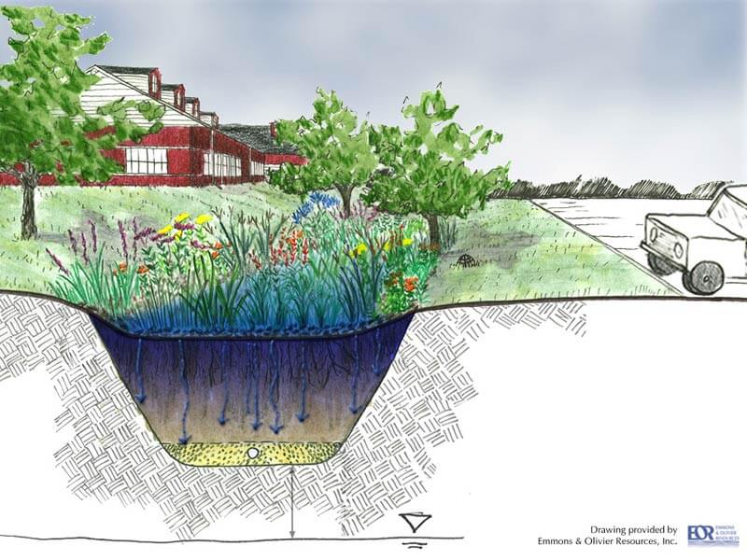
This Year: Post-Construction Runoff Control
Update bylaws/rules and regulations to include:
Requirements for Low-Impact Development (LID) practices
Pollutant removal requirements for stormwater treatment BMPs
Requirements for long-term operation and maintenance of stormwater BMPs
Requirements for the submission of as-built plans
1-Acre Threshold;
Includes Subdivisions

Slide 11
Questions

Slide 12
thank you
westonandsampson.com

Slide 13
APPENDIX

Slide 14
Planning Board Rules and Regulations: Updated Sections
§465-12. Site Plan Requirements

Slide 15
Planning Board Rules and Regulations: Updated Sections
§465-13. Site Plan Performance and Design Standards (Subsection E, Drainage)

Slide 16
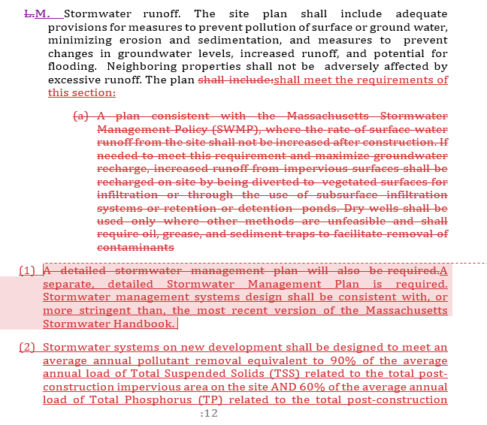
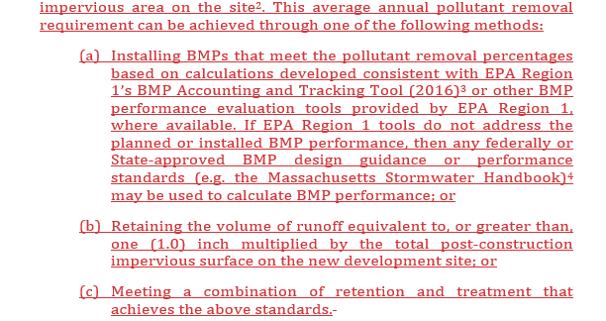
Planning Board Rules and Regulations: Updated Sections
§465-13. Site Plan Performance and Design Standards (Subsection M, Stormwater Runoff)

Slide 17
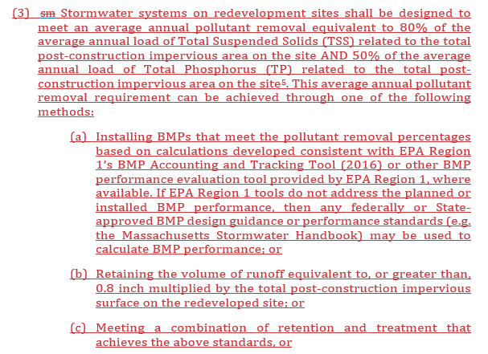
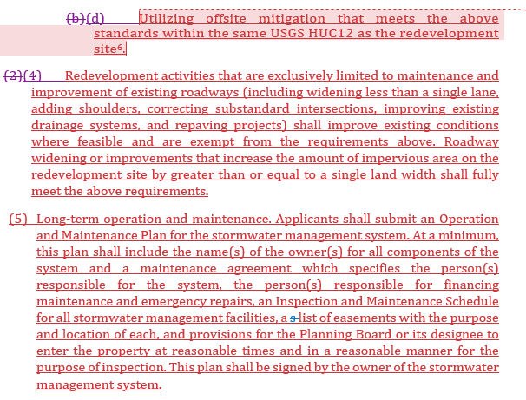
Planning Board Rules and Regulations: Updated Sections
§465-13. Site Plan Performance and Design Standards (Subsection M, Stormwater Runoff cnt.)

Slide 18
Subdivision Rules and Regulations: Updated Sections
Article IX, Design and Construction Standards, §465-36. Drainage, Subsection E.
Article X, Required Improvements for Approved Subdivision, §465-42. Duty of subdivider; specific improvements required, Subsection L.

