Slide 1
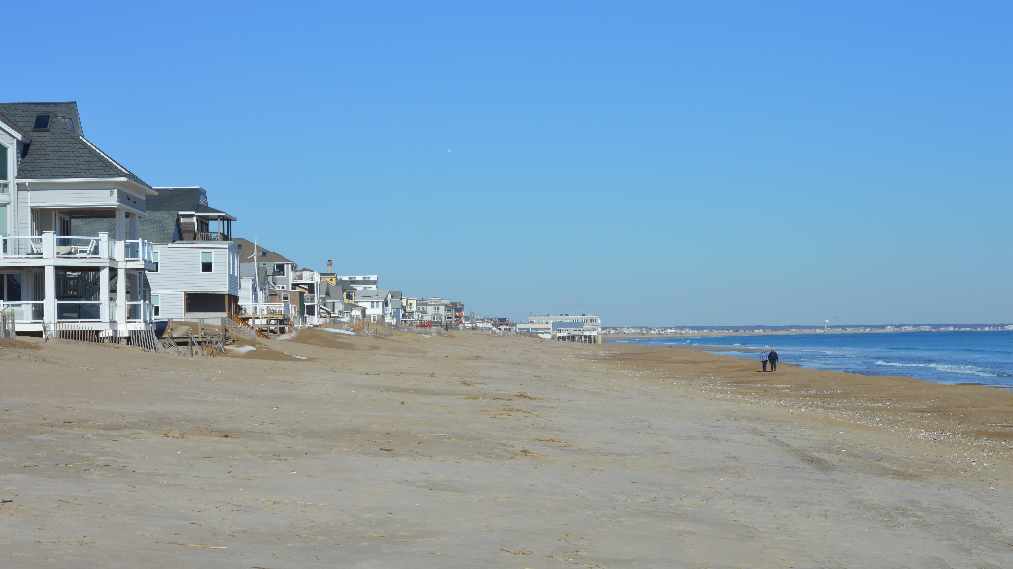
Salisbury master plan UPDATE 2022
barrett planning group

Slide 2
Project overview
Introduction
Engagement Process
Master Plan Chapters
Goals & Strategies
Next Steps

Slide 3
introductions
Committee Members
Deborah Rider (Chair)
Marty Doggett (Vice-Chair)
Mike Colburn
E.J. Dean
Derek DePetrillo
Connie Hellwig
Donna M Keefe
Terry Marengi Jr
Susan Pawlisheck
Ronalee Ray-Parrot
Chuck Takesian
Staff Contacts
Lisa Pearson
Daniel Ruiz
Judi Barrett; Principal
Tyler Maren; Project Lead
Fiona Coughlan
Alexis Lanzillotta

Slide 4
What is a master plan?
Long-term plan (typically 10 years)
Salisbury’s last MP was adopted in 2008 (almost 15 years ago!)
Contains several chapters or “elements”
Each chapter includes an Inventory/Assessment and Findings & Recommendations
Articulates a vision for the future – a basis for future decision-making
Includes an implementation plan
Where is the data from?
American Community Survey 2020
Census 2020 (population only)
Other official federal/state data sources
MassGIS
Assessor’s Records
Interviews with housing-related Town boards/committees
Public survey
And more!

Slide 5
Having a master plan matters because it:
helps communities discover what must be done to achieve their goals and avoid costly mistakes.
helps set priorities.
creates a policy framework for rules and regulations that guide development.
helps private developers understand the rationale for a community's land use goals and policies.
WHY HAVE A MASTER PLAN?
The Master Plan is your Road Map!

Slide 6
master plan 2022 updated sections
Land Use
Analyzes existing development trends and zoning regulations.
Transportation and Circulation
Focuses on issues with parking, traffic, and pedestrian and cyclist safety; focus in part on Beach Center
Economic Development
Evaluates the potential for economic development, and constraints.
Climate Change, Sea Level Rise, Resiliency
Addresses the impact of climate change, and how to improve sustainability in town.
Community Health
Focuses on topics like food systems, emergency preparedness, identifying gaps in social services for vulnerable groups.

Slide 7
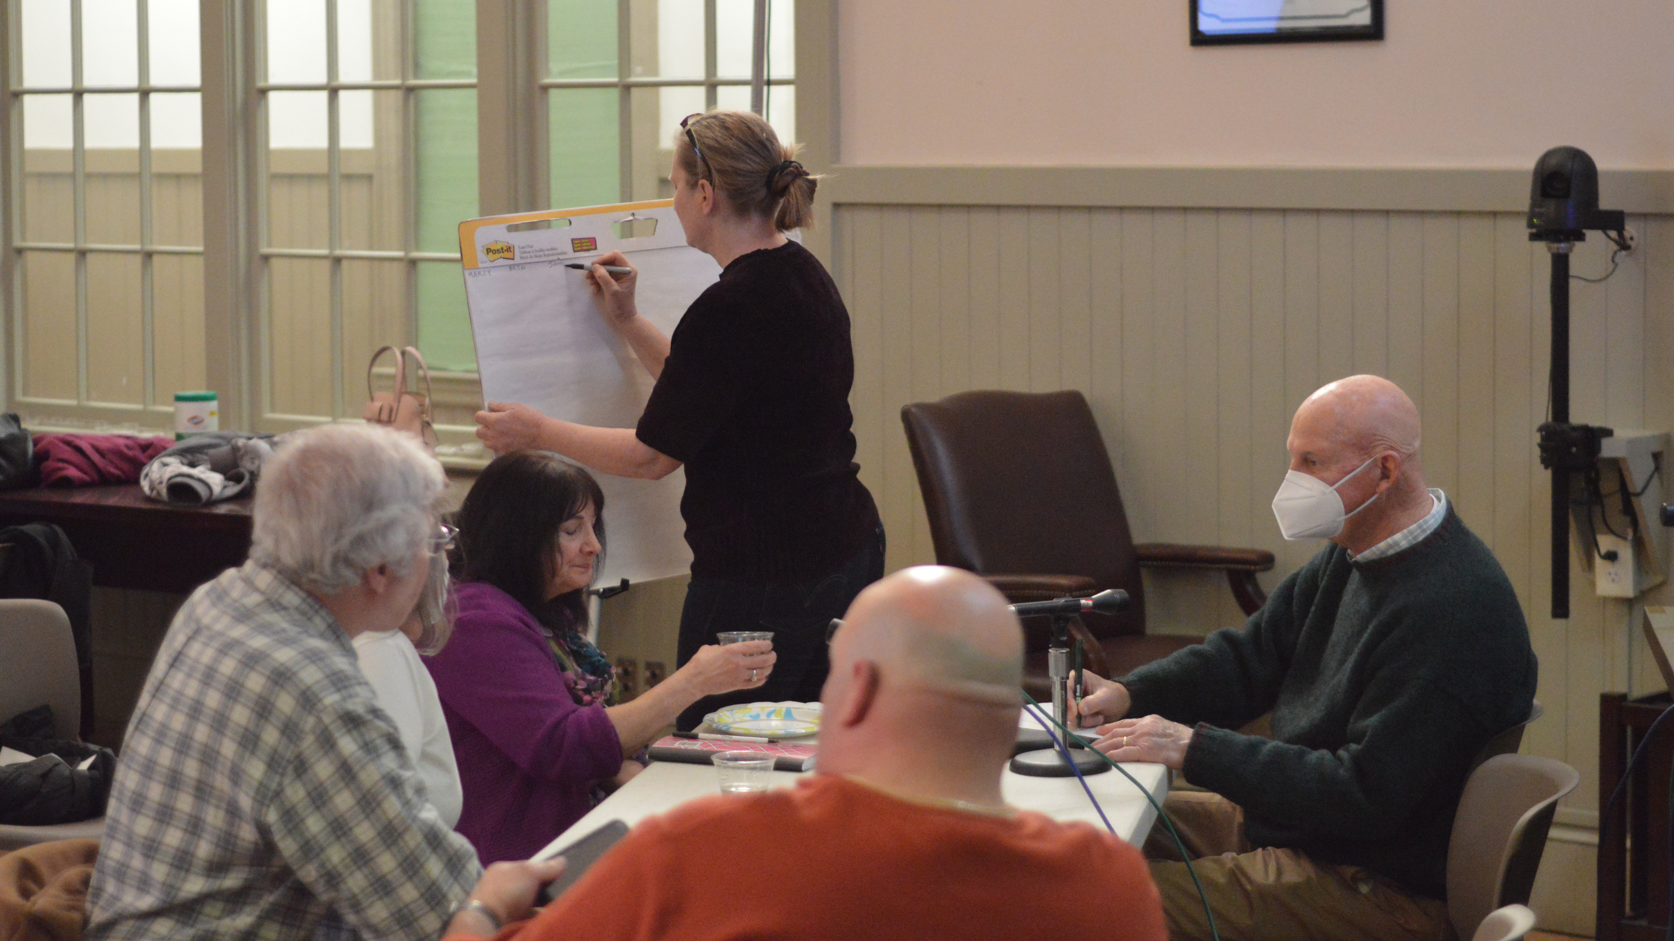
Community Engagement
Community Survey
May-June 2022; 300 responses
Community Meeting #1
In-person: April 4, 2022
Virtual: April 7, 2022
Community Meeting #2
In-person: June 9, 2022
Virtual: June 16, 2022
Poster display in Town Hall in June

Slide 8
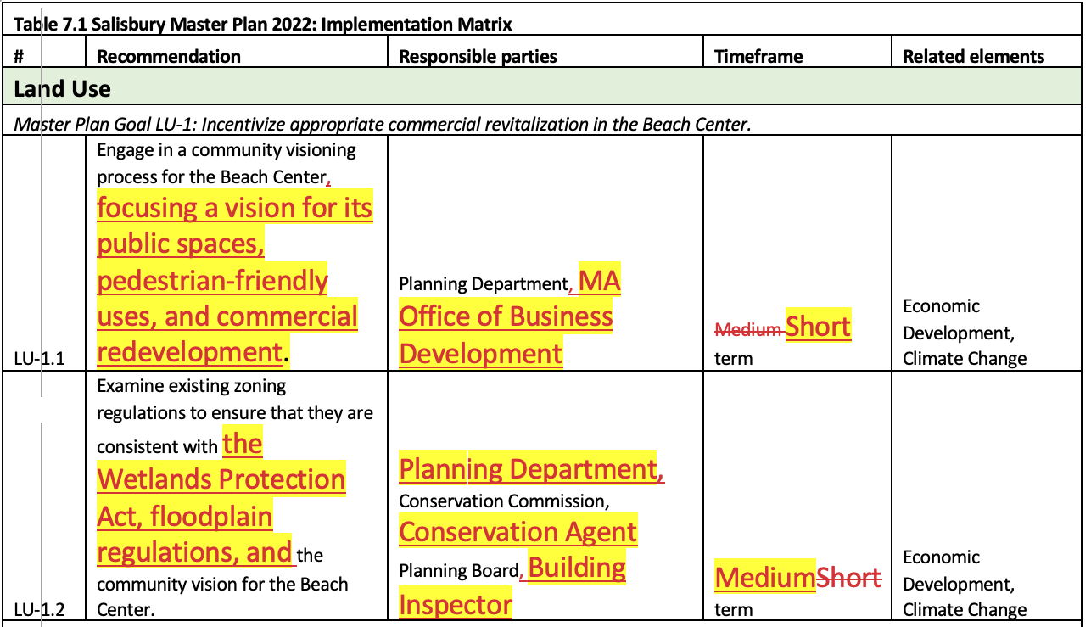
September 2022
Outreach and comments from the MP Committee, citizens, and many other boards and committees.
Probably over 1,000 Salisbury residents reached.

Slide 9
master plan 2022 goals
Land Use
Goal 1: Incentivize appropriate commercial revitalization in the Beach Center.
Transportation and Circulation
Goal 10: Manage summer traffic and parking issues in the Salisbury Beach area.
Economic Development
Goal 7: Encourage economic diversification, especially in main corridors.
Climate Change, Sea Level Rise, Resiliency
Goal 4: Improve environmental and economic resiliency to address climate vulnerability.
Community Health
Goal 13: Improve access to healthy local food and grocery options.
Goal 2: Adopt land use regulations that help preserve Salisbury’s natural environment and historic structures.
Goal 3: Improve and strengthen Salisbury’s commercial corridors.
Goal 5: Protect biodiversity and critical habitats through land use regulation and public education.
Goal 6: Build capacity to provide local leadership and advocacy at the state and federal levels, particularly concerning Salisbury Beach.
Goal 8: Attract new businesses to Salisbury through regulatory changes and creative marketing.
Goal 9: Increase staff and volunteer capacity for facilitating economic development.
Goal 11: Promote bicycling and walking as viable transit options.
Goal 12: Prioritize improving the poorest-quality roads and sidewalks for safety and ease of transit.
Goal 14: Invest in programs and resources to serve the needs of an aging population.
Goal 15: Address the ongoing problem of unsafe and unsanitary informal housing.

Slide 10
Implementation Matrix

Slide 11
What’s left?
Address any comments or concerns from the Planning Board
Solicit more photo submissions
Finish non-substantive elements of the final document: title page, table of contents, appendices

Slide 12
Next steps
EVENT | DATE
Planning Board Opens Public Hearing | September 28, 2022
Public Comment Period | Sept. 28-Oct. 12, 2022
Planning Board Accepts Plan | October 12, 2022
Presentation to Town Meeting | October 24, 2022

