Slide 1
MBTA Communities in Salisbury
April 3, 2023

Slide 2
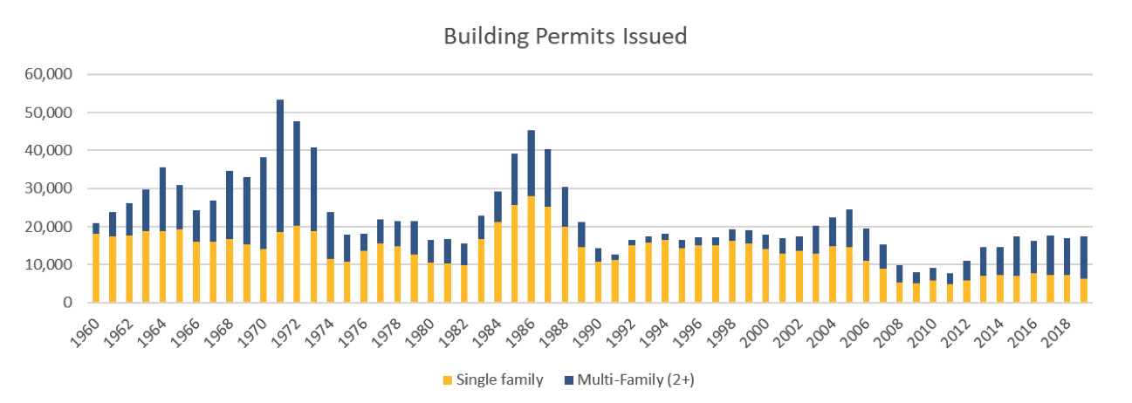
Why are the new regulations necessary?
Between 1960 and 1990, Massachusetts communities permitted almost 900,000 housing units. Since 1990, communities have permitted fewer than 470,000 new units.
There is an estimated shortage of 200,000 housing units in the state
Bullets and graphic on this slide from MA EOHED MBTA Communities Webinar presentation

Slide 3
The Housing Crisis
Massachusetts has among the highest, and fastest growing, home prices and rents of any state in the nation.
Rising costs have dramatically increased financial pressures on low- and middle-income families, forcing them to sacrifice other priorities in order to pay housing costs. High housing costs are a primary driver of homelessness.
The lack of housing production is an impediment to economic community development.
These high costs are a disadvantage as we compete economically against peer states. The risk of future job growth moving outside Massachusetts is rising due to the high costs of living.

Slide 4
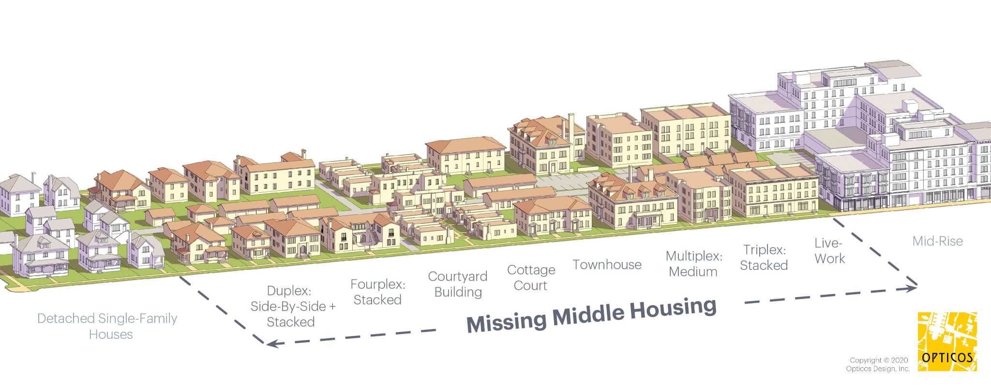
Missing Middle Housing

Slide 5
The Legislation
Section 3A. (a)(1) An MBTA community shall have a zoning ordinance or by-law that provides for at least 1 district of reasonable size in which multi-family housing is permitted as of right; provided, however, that such multi-family housing shall be without age restrictions and shall be suitable for families with children. For the purposes of this section, a district of reasonable size shall: (i) have a minimum gross density of 15 units per acre, subject to any further limitations imposed by section 40 of chapter 131 and title 5 of the state environmental code established pursuant to section 13 of chapter 21A; and (ii) be located not more than 0.5 miles from a commuter rail station, subway station, ferry terminal or bus station, if applicable.

Slide 6
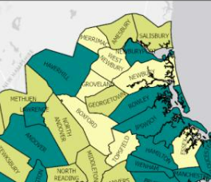
Merrimack Valley Region
Commuter Rail Communities
Adjacent Communities
Adjacent Small Towns

Slide 7
Merrimack Valley MBTA Communities
Commuter Rail Communities:
District must be a minimum of 50 acres or 1.5% of developable land, whichever is less
Zoning must allow for up to 15 units per acre
Zoning district must have a capacity for multifamily units equal to 15% of the community’s entire housing stock, or equal to the unit capacity in the district given the 15 units/acre requirement, whichever is greater
Some of the district area must be within 0.5 miles of a transit station
MBTA Adjacent Communities:
District must be a minimum of 50 acres or 1.5% of developable land, whichever is less
Zoning must allow for up to 15 units per acre
Zoning district must have a capacity for multifamily units equal to either 10% of the community’s entire housing stock, or equal to the unit capacity in the district given the 15 units/acre requirement, whichever is greater
Zoning district should have reasonable access to a transit station
MBTA Adjacent Small Towns:
Have within its boundaries less than 100 acres of developable station area AND has a population density of less than 500 persons/ sq. mile or a population of not more than 7,000 year-round residents
Zoning must allow for up to 15 units per acre
Zoning district must have a capacity for multifamily units equal to 5% of the community’s entire housing stock
Zoning district should have reasonable access to a transit station

Slide 8
What does this look like in each Merrimack Valley community?
Community | Comm. Type | 2020 Housing Units | Min. # Of Units in District | % District in Station Area | Community | MBTA Comm. Type | 2020 Housing Units | Min. # Of Units in District | % District in Station Area
Amesbury | AC | 7889 | 789 | 0% | Merrimac | AST | 2,761 | 138 | 0%
Andover | CR | 13,541 | 2,031 | 50% | Newbury | AST | 3,072 | 154 | 0%
Boxford | AST | 2,818 | 141 | 0% | Newburyport | CR | 8,165 | 1,292 | 20%
Georgetown | AC | 3,159 | 750 | 0% | N. Andover | AC | 11,914 | 1,191 | 0%
Groveland | AST | 2,596 | 130 | 0% | Rowley | CR | 2,405 | 601 | 20%
Haverhill | CR | 27,927 | 4,189 | 50% | Salisbury | AC | 5,305 | 750 | 0%
Lawrence | CR | 30,008 | 4,501 | 40% | W. Newbury | AST | 1,740 | 87 | 0%
Methuen | AC | 20,194 | 2,019 | 0% | TOTAL | - | 143,494 | 18,763
AC = Adjacent Community | AST = Adjacent Small Town | CR = Commuter Rail

Slide 9
Timeline for Implementation
January 31, 2023
December 31, 2025
Adjacent Small Towns must adopt zoning amendment
Rapid transit communities must adopt zoning amendment

Slide 10
Why Do We Need to Comply?
Communities that do not comply with housing choice legislation will be ineligible for the following state grant programs:
Housing Choice Community Grants
MassWorks Infrastructure Grants
Local Capital Projects Funds
“Determinations of compliance also may inform funding decisions by EOHED, DHCD, the MBTA and other state agencies which consider local housing policies when evaluating applications for discretionary grant programs, or making discretionary funding decisions.”
Non-compliant communities have lost some of their housing authority funding
Attorney General recently released guidance stating the law is not optional

Slide 11
Next Steps
Identifying potential districts
Obtain community input and feedback
Complete DHCD’s Compliance Model spreadsheet
Draft zoning bylaw
Approval at town meeting

Slide 12
Housing Toolkit: FAQs on New Development
We anticipate that residents may have questions about the impacts of potential new multifamily development on the town. MVPC can help provide community-specific answers to each of these questions (and other questions not mentioned here) upon request.
Why do we need new housing? Won’t it change the character of our town?
Won’t new development bring too many school aged children into town, putting stress on our school system?
Won’t new development put additional financial pressures on our public services, such as police, fire, DPW, etc?
What will the environmental impacts of new development be—will our wetlands and water supply be negatively impacted?
What impact will development have on traffic in town?

Slide 13
Questions & Discussion

