Slide 1
Salisbury MBTA Communities Forum
Monday, March 18th, 2023 | 6:00 – 7:30 PM

Slide 2
Agenda
Background on Multi-Family Housing
Questions
Background on MBTA Communities
Purpose and summary of the law
What the law means for Salisbury
Salisbury’s Potential Zoning Districts
Factors in considering districts
Dimensional requirements + details of each district
Questions and feedback
Next Steps

Slide 3
Background on Multi-Family Housing

Slide 4
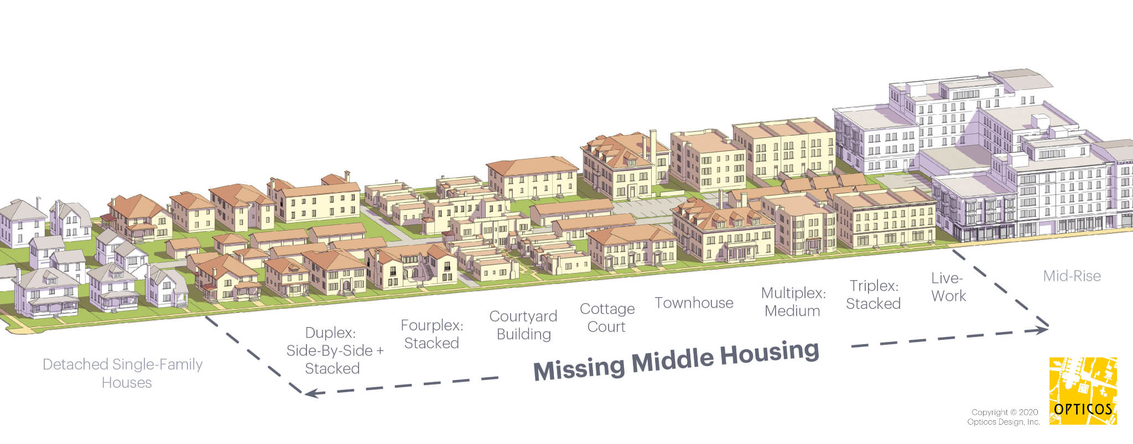
What is Multifamily Housing?
Any housing structure that contains three or more dwelling units (apartments or condominiums)
Does not need to be large apartment buildings, can be smaller triplexes, fourplexes, townhouses, etc.

Slide 5
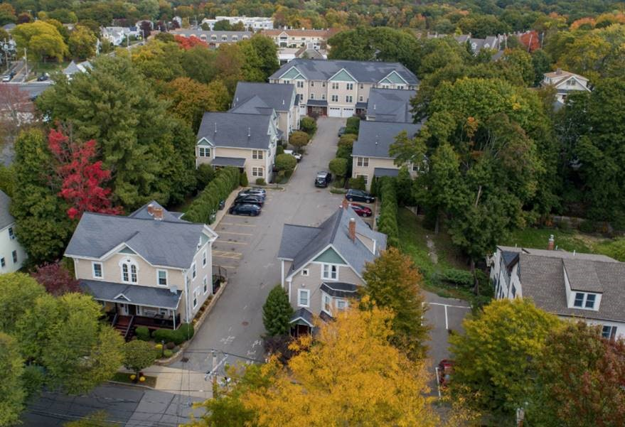
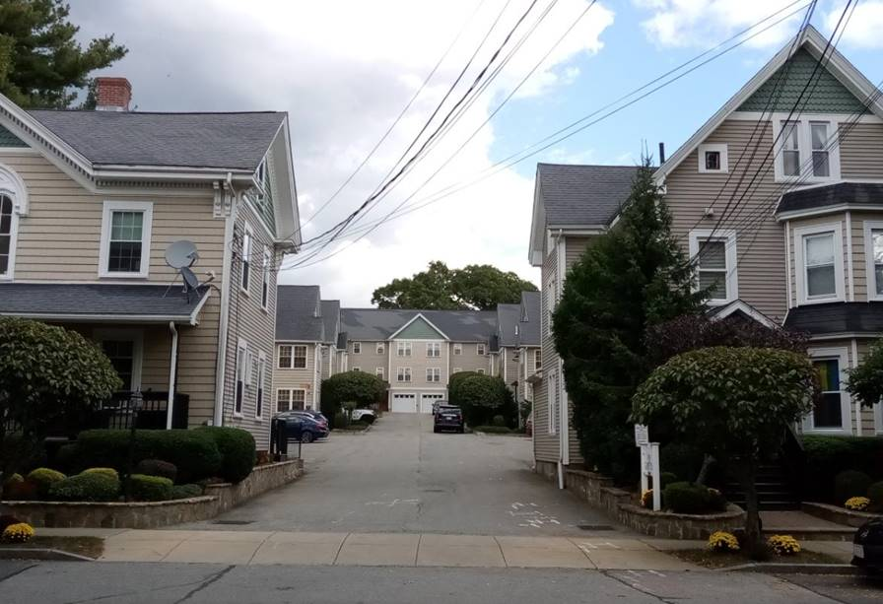
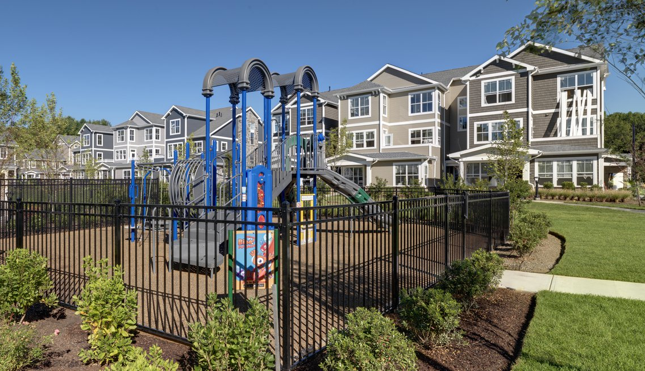
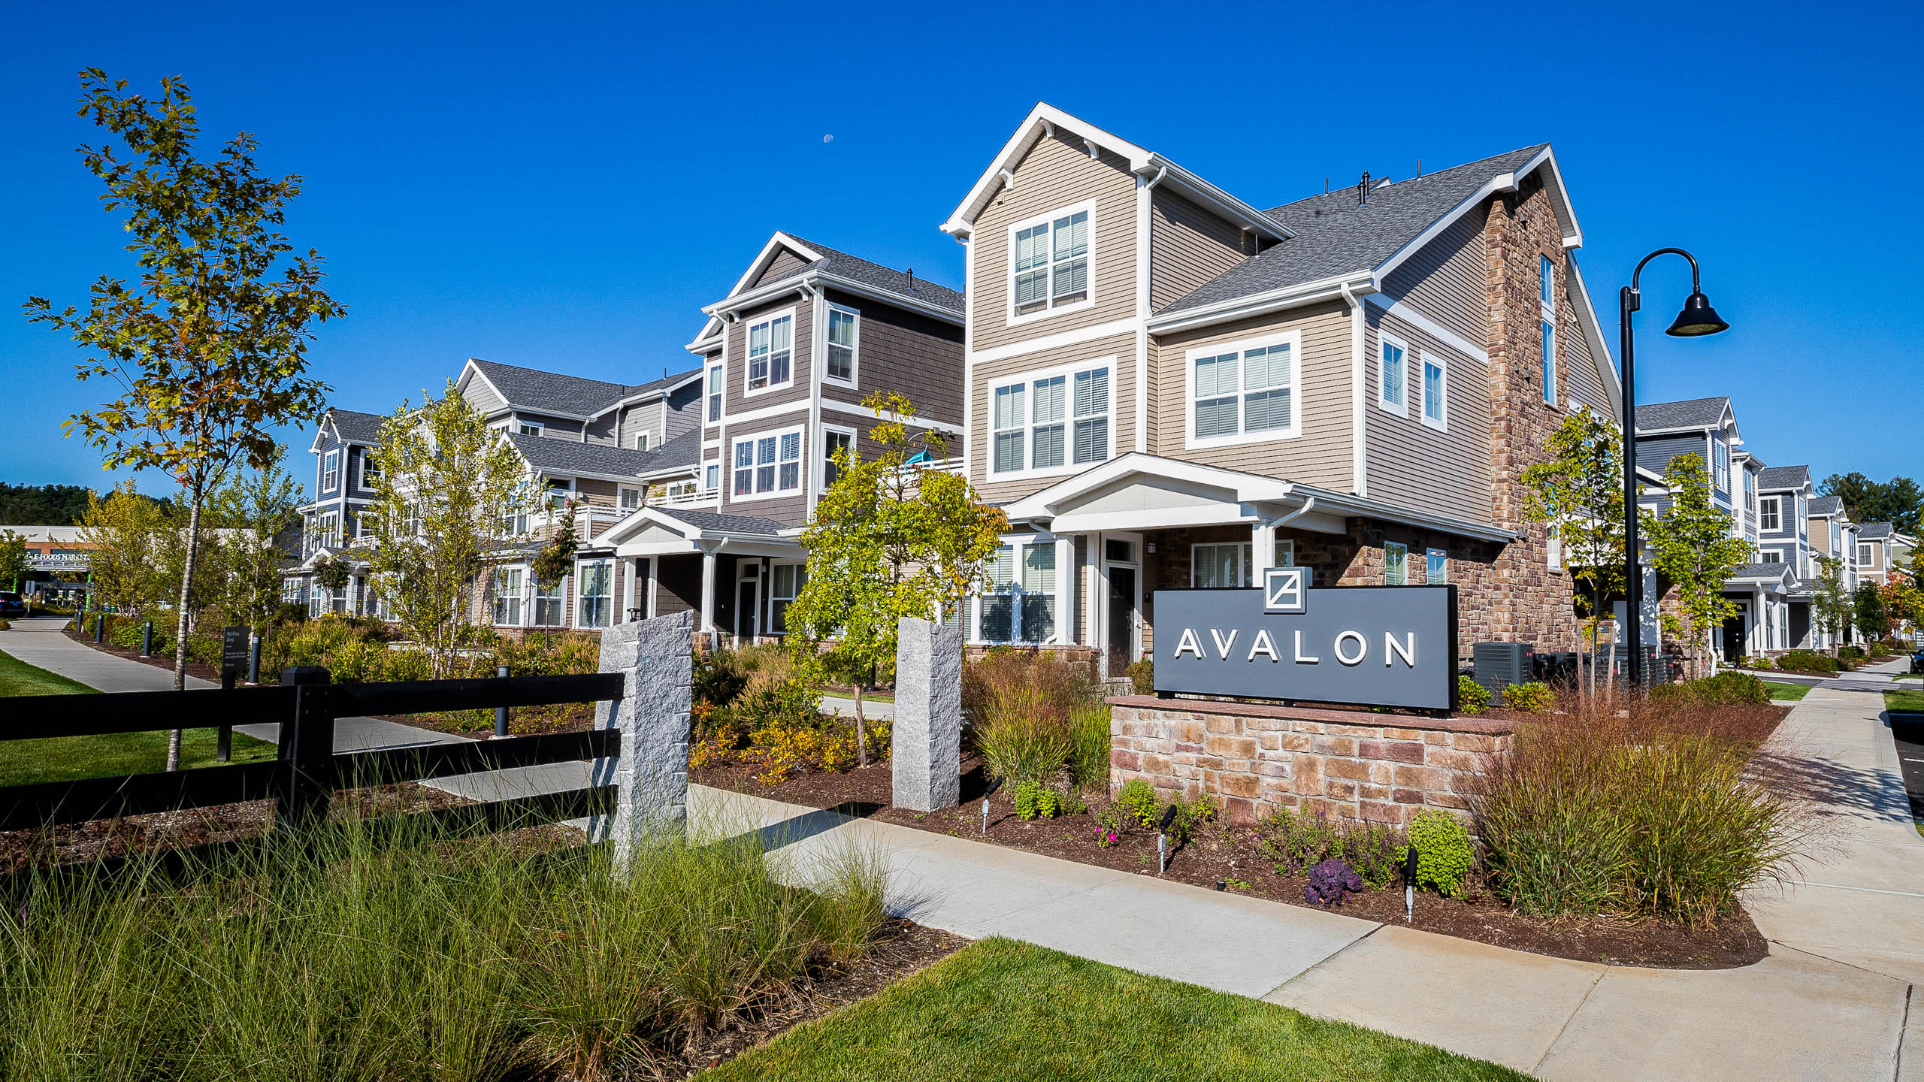
What Could Multifamily Look Like?
Natick, MA
Sudbury, MA

Slide 6
Background on MBTA Communities

Slide 7
History of MBTA Communities Legislation
The MBTA Communities Law was passed by the MA Legislature in 2021
The law applies to all cities & towns that have MBTA transit stops or are bordering communities with transit stops
The goal of the legislation is to address Massachusetts’ housing shortage
Requires communities to change zoning regulations to allow multi-family housing by right in one or more zoning districts
Law requires the creation of a zoning district - it is not a production mandate
Notes:
Explain 3A legislation in simple terms

Slide 8
The Legislation
Section 3A – MBTA communities must zone for multi-family housing
Zoning requirements to comply with the statute:
Multi-family housing is permitted as of right
No age restrictions and suitable for families with children (cannot restrict unit size)
Minimum gross density of 15 units per acre
Within 0.5 miles of a commuter rail station, subway station, ferry terminal, or bus station*
*This requirement does not specifically apply to Salisbury, which is an Adjacent Community
Notes:
Explain 3A legislation in simple terms
Explain that for Salisbury, the way to build multi-family housing is to build in Beach Commercial, 40B – is this bylaw more beneficial than a 40B, though it would give us less affordable housing. If housing is built in these districts, 10% would be affordable over 19 units, but the rest would be most market rate.

Slide 9
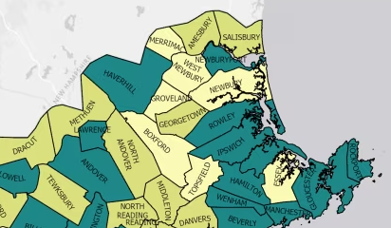
Merrimack Valley Region

Slide 10
Salisbury’s Requirements
MBTA Adjacent Communities, Including Salisbury:
District must be a minimum of 50 acres or 1.5% of developable land, whichever is less
Zoning must allow for a minimum of 15 units per acre
Zoning district must have a capacity for multifamily units equal to either 10% of the community’s entire housing stock, or equal to the unit capacity in the district given the 15 units/acre requirement, whichever is greater
Zoning district should have reasonable access to a transit station
Salisbury is required to zone for 750 Units
Existing inclusionary zoning requirements require the construction of affordable units in developments over 19 units
Developments still need to comply with inclusionary zoning, notice of intent, and site plan review
Notes:
Current districts are 1% of total land area (not necessarily developable)
10% of Salisbury’s housing stock is about 530 units

Slide 11
Timeline for Implementation
December 31, 2025
Adjacent Small Towns must adopt zoning amendment
Target: May 2024 Annual Town Meeting

Slide 12
Why Compliance Matters: The law is NOT optional
The state has outlined 13 grants where communities without compliant 3A districts will be less competitive applicants compared to communities that do comply
These are in addition to the other programs the statute already said a community would be ineligible for: MassWorks, Housing Choice, and Local Capital Projects Fund (which partially funds Housing Authorities)
Community Planning Grants
MA Downtown Initiative
Urban Agenda
Rural & Small Town Development Fund
Brownfields Redevelopment Fund
Site Readiness Program
Underutilized Properties Program
Collaborative Workspace Program
Real Estate Services Technical Assistance
Commonwealth Places Programs
Land Use Planning Grants
Local Acquisitions for Natural Diversity (LAND) Grants
Municipal Vulnerability Preparedness (MVP) Planning & Project Grants

Slide 13
Questions about the law?

Slide 14
Zoning Districts

Slide 15
Factors In Considering Potential District Locations
Location proximate to transit access, i.e. Newburyport Commuter Rail
Walkability & pedestrian access improvements
Opportunity to improve gateways into Town
Access to Town amenities & public services
Real potential of future development
Addressing Salisbury’s housing needs

Slide 16
Dimensional Requirements
For all districts, we are considering the following potential dimensional requirements in the bylaw:
Minimum Lot Size: 21,780 sq. ft. (1/2 acre)
Max Building Height: 3 Stories
Setbacks: 50 ft. front yard, 30 ft. side and 20 ft. back yards
Max lot coverage: 25%
Minimum open space required: 20%
Parking: average of 1.5 spaces per unit
Opportunity for special permits
Notes:
Mention how these parameters reflect the existing setbacks, but have room to increase them to protect abutters

Slide 17
Potential District Locations Identified 4/3/2023

Slide 18
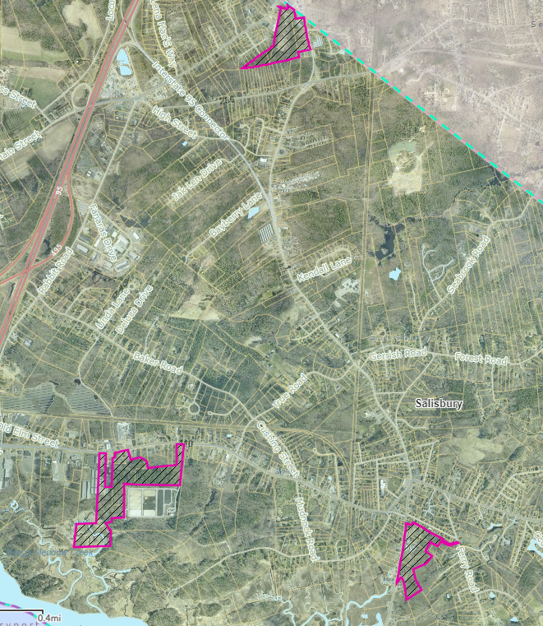
Proposed Overlay Districts at 1/11 Forum
Subdistricts:
Elm Street
55 acre district
Bridge Road
23 acre district
McKenna Mountain
25 acre district
3
1
2
Notes:
Lisa: these were the areas that were selected initially, and have since narrowed down for xyz reason. Lisa will discuss specific districts and why.

Slide 19
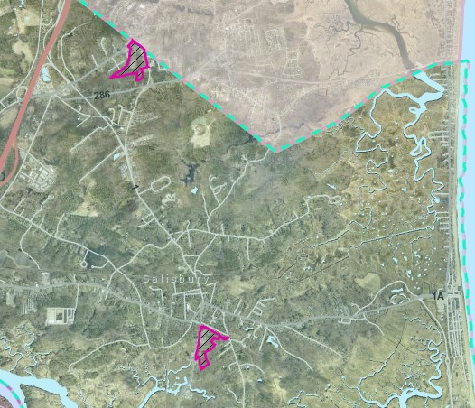
Current Proposed Overlay Districts
Subdistricts:
Bridge Road
23 acre district
McKenna Mountain
28 acre district
2
1
Notes:
Lisa: these were the areas that were selected initially, and have since narrowed down for xyz reason. Lisa will discuss specific districts and why.

Slide 20
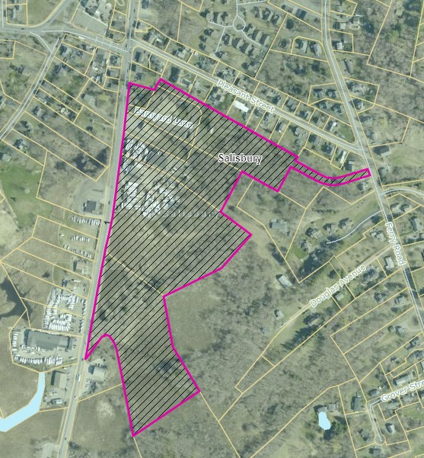
Bridge Road – Subdistrict 1
23-acre district
Along major road (Rt. 1) for efficient access and transportation options
Close to amenities like pharmacy, bank, neighbors
Close access to Newburyport Commuter Rail Station
Opportunity to improve area near the center of town
Notes:
Explain the concept of gentle density
Opportunity to improve appearance of the area, positive difference, and can control parameters including setbacks and design guidelines

Slide 21
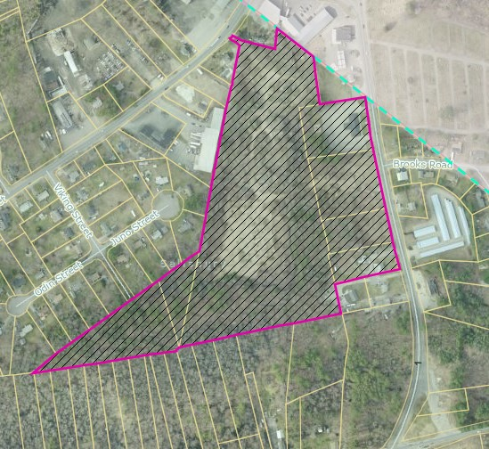
McKenna Mountain – Subdistrict 2
28-acre district
Along major road (Rt. 1) for efficient access and transportation options
Close access to New Hampshire
Opportunity to improve gateway into town
Notes:
Explain the concept of gentle density

Slide 22
Questions and feedback on the proposed districts

Slide 23
Next Steps
MVPC Staff & Town staff will continue public outreach on the proposed MBTA Communities districts
Planning Board Public Hearing on March 27th
Finalize proposed zoning amendment for May 2024 Annual Town Meeting

