Slide 1
Solar Bylaw Workshop
November 21st, 2022

Slide 2
What is currently allowed for Solar uses?
As currently written in Article XXII Solar Photovoltaic Installations, the following uses are currently allowed:
Large-Scale ground mounted solar photovoltaic installations.
On-site solar photovoltaic installations. (accessory use for a property that already has another existing use)
Large Scale ground mounted solar & On-site solar is allowed in the following zoning districts:
Accessory roof mounted solar photovoltaic installations.
Accessory roof mounted solar panels are allowed on any residential house in any zoning districts.

Slide 3
What is currently not allowed for Solar uses?
By-right Medium-scale & Small-scale ground mounted solar photovoltaic installations.
These smaller sized ground mounted solar arrays are not allowed under our existing bylaw as a stand alone use.

Slide 4
Existing Definitions
LARGE-SCALE SOLAR PHOTOVOLTAIC INSTALLATION: A solar photovoltaic system that is structurally mounted on the ground and is not roof-mounted, and has a minimum rated nameplate capacity of 250 kW DC.
RATED NAMEPLATE CAPACITY: The maximum rated output of electric power production of the photovoltaic system in direct current (DC).
ON-SITE SOLAR PHOTOVOLTAIC INSTALLATION: A solar photovoltaic installation that is constructed at a location where other uses of the underlying property occur.
ROOF-MOUNTED SOLAR ENERGY INSTALLATION: Solar photovoltaic arrays placed on the roof of residences/carport, or commercial, industrial or institutional buildings and Town-owned municipal buildings.

Slide 5
New Proposed Definitions
LARGE-SCALE GROUND-MOUNTED PHOTOVOLTAIC INSTALLATION: A solar photovoltaic system that is structurally mounted on the ground that occupies 32,000 square feet or more of surface area of solar panels.
MEDIUM-SCALE GROUND-MOUNTED PHOTOVOLTAIC INSTALLATION: A solar photovoltaic system that is structurally mounted on the ground that occupies more than 2,100 square feet but less than 32,000 square feet of surface area of solar panels.
SMALL-SCALE GROUND-MOUNTED PHOTOVOLTAIC INSTALLATION: A solar photovoltaic system that is structurally mounted on the ground that occupies 2,100 square feet or less of surface area of solar panels. Small-scale systems would only be allowed as an accessory use.
PHOTOVOLTAIC BUFFER STRIP: A strip of land between the solar photovoltaic arrays, and any structures accessory thereto, and the boundary of the parcel, reserved for plant material, berms, walls, or fencing to serve as a visual barrier.
PHOTOVOLTAIC PLANT MATERIAL: Trees or shrubs of a type and height that sufficiently screen the arrays without blocking necessary sun that would hinder the product performance, including ground cover that would screen the lower portion of the arrays.

Slide 6
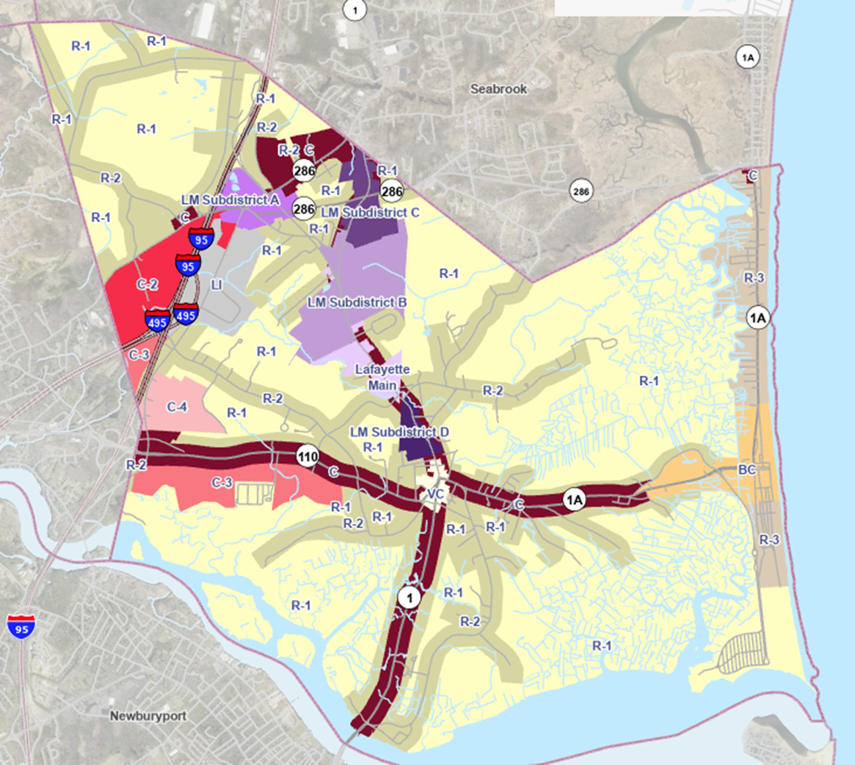
Zoning Districts that currently allowing Large-Scale & On-site Photovoltaic installations
Large-scale ground-mounted solar is allowed in the following districts: R1, C3, C4, I, LM.
On-site solar: R1, C3, C4, I, LM, LM-B, LM-C

Slide 7
Proposed zoning districts to allow Medium-Scale
Proposed new district to allow Medium-Scale: R2
Minimum allowed lot size: 43,560 SF or 1.0 acres
Allowed as by-right use in following zones: R1, R2, C3, C4, I, LM
Allowed as accessory use (on-site solar photovoltaic system) in following zones: R1, R2, C3, C4, I, LM-B, LM-C

Slide 8
Zoning districts that allow Small-Scale Ground-Mounted Installations
Allowed as an accessory use in following zones: R1, R2, C3, C4, I, LM-B, LM-C

Slide 9
Small-Scale/Roof-Mounted Permitting Process
Recommendation:
Small-Scale Ground-Mounted Solar Photovoltaic and Roof-Mounted Solar Energy Installations:
These would only need a Building Permit issued by the Building Inspector. No Site Plan Review would be required. Permits from the Conservation Commission may still be needed if the small-scale ground-mounted system is within the 100ft wetland buffer.
A Special Permit from the Planning Board shall be required for a small-scale ground-mounted system when the height of the panel exceeds 20ft at its maximum extension.
An as-built plan would be required prior to final inspection by the Building Inspector. The as-built plan shall be submitted to the Building Inspector and Planning Department. Roof-mounted solar installations are excluded from this.

Slide 10
Large-Scale & Medium-Scale Permitting Process
Existing Large-Scale Permitting Process:
Large-scale and medium-scale ground mounted solar photovoltaic installations with more than 2,100 square feet in size shall undergo site plan review by the Planning Board prior to construction, installation or modification as provided in this section. A large-scale or medium-scale solar photovoltaic installation shall require site plan review as a major project under Article XVIII. An on-site photovoltaic installation shall require site plan review as a minor project under Article XVIII. Small-scale solar photovoltaic installations are excluded from Site Plan Review. The site plan review application shall be filed in accordance with Article XVIII.
Site Plan Review Application would require submission of required documents under §300-146.1.
Proposed change is to add medium-scale in with the large-scale permitting process.

Slide 11
Dimension and Density Requirements
Small-Scale Ground-Mounted Setbacks: The purpose of setbacks is to mitigate adverse impacts on abutting properties. For small-scale, ground-mounted solar photovoltaic installations, front, side and rear setbacks shall be as follows:
Front yard setbacks for small-scale ground-mounted photovoltaic installations shall have a front lot setback no closer than the existing foundation of the primary dwelling to the front property line, except when the existing foundation of the primary dwelling is more than 125 feet from the front property line or otherwise if determined appropriate by the Building Commissioner.
Side yard and rear yard setbacks for small-scale ground-mounted photovoltaic installations shall meet the side yard and rear yard setback as set forth in the Town of Salisbury Dimension Control Table.
Every abutting property shall be visually screened by a buffer strip from the project through any one or combination of the following location, distance, plantings, existing vegetation and fencing (not to exceed 6 feet).
Large-Scale or Medium Scale Ground-Mounted Setbacks: The purpose of setbacks is to mitigate adverse impacts on abutting properties. For large-scale and medium-scale, ground-mounted solar photovoltaic installations, front, side and rear setbacks shall be as follows:
Minimum of 50 feet
Every abutting property shall be visually screened by a buffer strip from the project through any one or combination of the following location, distance, plantings, existing vegetation and fencing (not to exceed 6 feet).

Slide 12
Natural Resources Protection Bylaw Workshop
November 21st, 2022

Slide 13
Natural Resources Protection Bylaw
Currently, protection of natural resources in Salisbury is through the MA Wetlands Protection Act (WPA).
The WPA identifies 8 public interests to protect:
public/private water,
supply groundwater supply
flood control
storm damage prevention
prevention of pollution
protection of land containing shellfish
protection of wildlife habitat
protection of fisheries.
The WPA does not protect:
Open Space
upland Forests
wildlife not endangered
wildlife corridors
Isolated wetlands
Vernal pools not certified or otherwise protected.
Land effected by sea level rise.

Slide 14
We’re not reinventing the wheel
Amesbury, Newburyport, Newbury, West Newbury, Merrimac, Rowley, Haverhill, Ipswich to name a few of the surrounding communities that all have local regulations for natural resource protection.
In developing Salisbury’s draft bylaw we referenced Amesbury, Newbury, Newburyport, Natick, Medford, Framingham, and Concord regulations.
The main content of the draft bylaw reiterates current regulations under the WPA and will use the same permitting platform for review. Applicants will not need to file additional permits.
Adopting a bylaw allows us to clarify procedure, adopt rules and regulations, and expand protection where needed.

Slide 15
What is different?
Section 1.1 - Purpose
Expanded on the “interests” from the WPA: New additions in yellow
Public or private water supply
aquifer protection district
groundwater
flood control
storm damage prevention
water pollution
fisheries
shellfish
barrier beach
erosion and sedimentation control
wildlife
wildlife habit
agriculture
aquaculture
recreation
and climate change adaptation.
*will include open space in next draft
Section 1.2 – Jurisdiction
Expanded to include:
Isolated vegetated wetland
vernal pool’s not certified
Any land within the Aquifer Protection District as defined in Article X – B, the Water Resource District By-Law of the Town of Salisbury.

Slide 16
Section 1.3 – Definitions
Definitions have been greatly expanded to include the flowing definitions
Alter:
Coastal engineering structure:
Development:
New development:
Redevelopment:
Redevelopment and Development:
Footprint:
Intermittent stream:
Isolated vegetated wetland:
No-disturbance zone:
Person:
Structure:
Substantial Improvement:
Vernal pool habitat:
Wildlife corridor
Section 1.4 – Barrier Beach Protection
No additional requirements proposed. Language provides clarification to existing WPA regulations.
May want to include additional clarification on fences or required clearance.

Slide 17
Section 2.1 – Exceptions
No additional requirements proposed. Language provides clarification to existing WPA regulations.
Section 2.2 - Variances, hardship and mitigation
Allows for exceptions to the bylaw under outlined conditions. Applies only to the bylaw and not the WPA
Section 3.1 – Application for Permits and Request for Determination
Most permitting will take place through WPA forms.
Section 3.2 – Independent Consultants
Outlines the use of independent consultants for Commission Peer Review. This is a clarifying section and does not alter current operation.
Section 3.3 – Coordination with other Boards or Departments
This is a clarifying section and does not alter current operation.
Section 3.4 – Fees
A bylaw will allow the Town to Collect fees to offset the cost of administrative operation of the Commission, hiring of town counsel, and additional permitting review.
Fees in the Conservation fund can also be used to fund projects such as land acquisition and expenditures related to conservation grant applications and conservation planning.

Slide 18
Section 4.1 – Notice and Hearings
No additional requirements proposed. Language provides clarification to existing WPA regulations.
Section 5.1 –Permits, Conditions, and Determinations
New addition of protection for Isolated Vegetated Wetlands. Contractors will often replicate even though its not required because the loss of these areas causes flooding issues. This change would require it, protecting abutters when this is not done.
New addition of a 25 foot no- disturbed zone. This zone can be disturbed if the conditions of the bylaw are met.
New addition of protection for vernal pools. Vernal pools need to meet very stringent standards and are rarely certified. This would protect these resource areas without the certification but the standards must still be met.
Section 6.1 – Regulations:
The commission currently has rules and regulations. These would need to be updated. Rules and regs can only be changed through the public hearing process, but do not require a town meeting vote.
Section 7.1 – Security:
No change.

Slide 19
Section 8.1 – Enforcement:
Would allow the Commission to fine for violation of permits and enforcement orders.
Would allow the Commission to pursue legal recourse
Section 9.1 – Burden of Proof
No change.
Section 10.1 – Relation to the Wetlands Act
No change.
Section 11.1 – Severability
No change.

