Slide 1
Welcome!
North End Boulevard (Route 1A) Reconstruction
Salisbury, MA | 607710
PUBLIC MEETING
SALISBURY, MA
NOVEMBER 19 | 7:00 PM

Slide 2
Project Team
North End Boulevard Reconstruction
Salisbury, MA | 607710
Town of Salisbury
Project Proponent
MassDOT District 4
Project Proponent and Responsible for Administering the Design Process
Jacobs Engineering
Responsible for Design

Slide 3
Introduction
North End Boulevard Reconstruction
Salisbury, MA | 607710
Introduction
Town of Salisbury
Neil Harrington – Town Manager and Facilitator
Lisa Pearson – Town Planning Director
Lisa DeMeo – Director of Public Works
MassDOT
Frank Suszynski, P.E. - MassDOT Deputy District 4 Highway Director
Brian Fallon, P.E. – MassDOT District 4 Project Development Engineer
Jacobs Engineering
Becky Williamson, P.E. – Jacobs Project Executive
Patrick Crowley, P.E. – Jacobs Project Manager
Lou Rabito, P.E. – Technical Advisor
Lindsey Vazquez, EIT – Jacobs Project Engineer

Slide 4
Project Scope
North End Boulevard Reconstruction
Salisbury, MA | 607710
Project Scope
Reconstruction of 2 miles of North End Boulevard (Route 1A) – from Beach Road and the New Hampshire State Line
Inclusion of Complete Streets Elements
Intersection Design at Central Avenue
ADA Accessibility
Bicycle and Pedestrian Accommodations
Drainage System Improvements

Slide 5
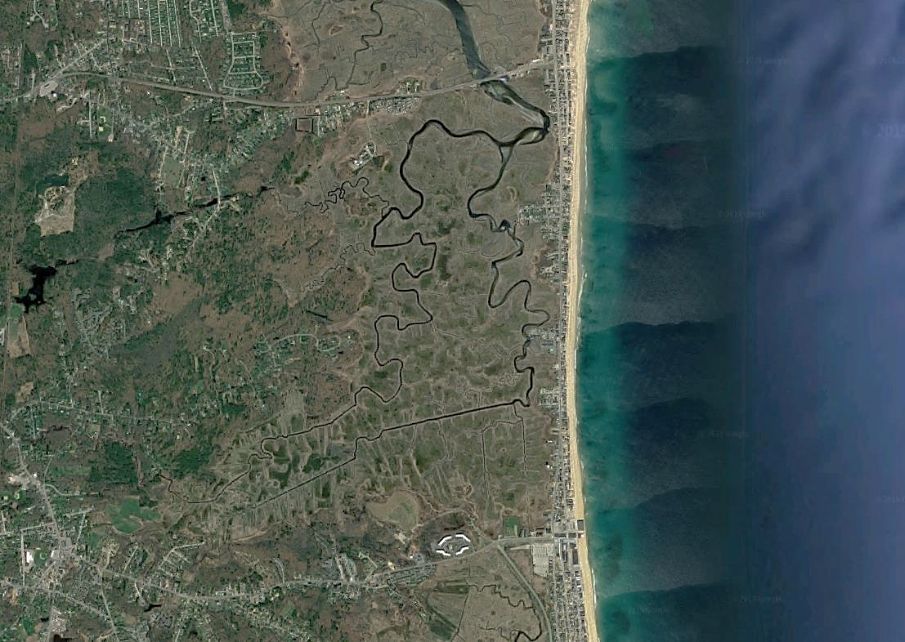
Project Area
North End Boulevard Reconstruction
Salisbury, MA | 607710
Project Area
ROUTE 286
NORTH END BOULEVARD
ROUTE 1A

Slide 6
Why do we need this project?
North End Boulevard Reconstruction
Salisbury, MA | 607710
.
Improve Overall Roadway Safety
Complete Streets
Central Avenue Intersection
Drainage Improvements

Slide 7
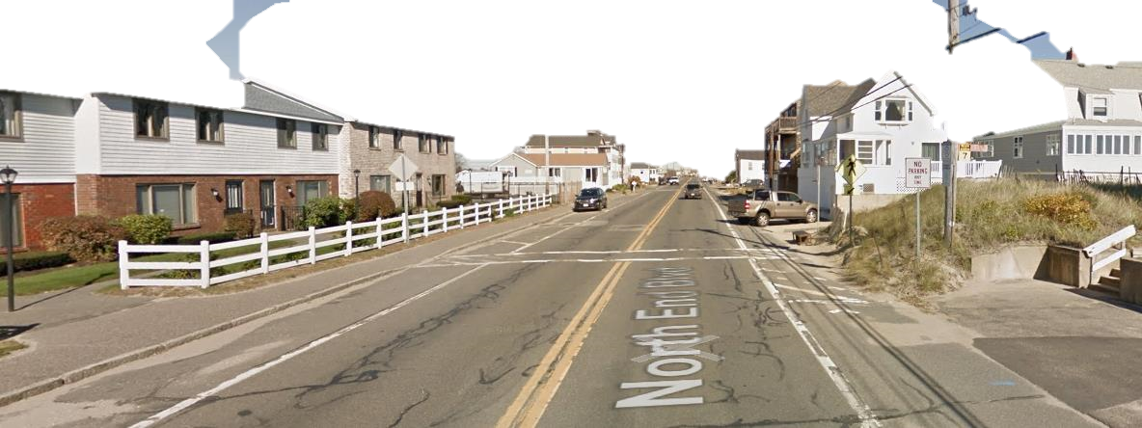
North End Boulevard Reconstruction
Salisbury, MA | 607710
Existing Issues
Intersection Safety at Central Avenue
Pavement Condition
Deficient Pedestrian Accommodation
Deficient Bicycle Accommodation
Drainage

Slide 8
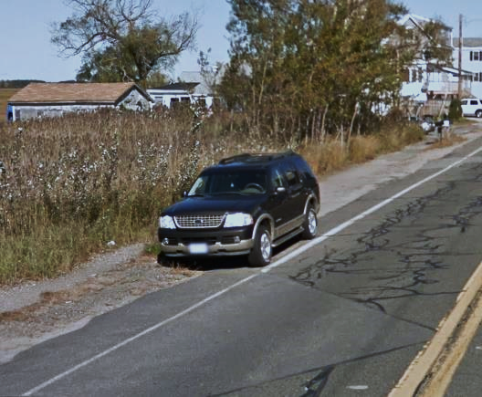
North End Boulevard Reconstruction
Salisbury, MA | 607710
Existing Issues (cont.)

Slide 9
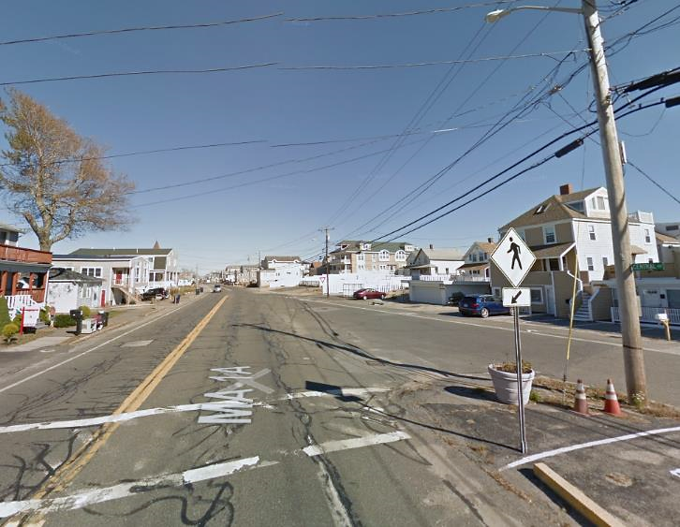
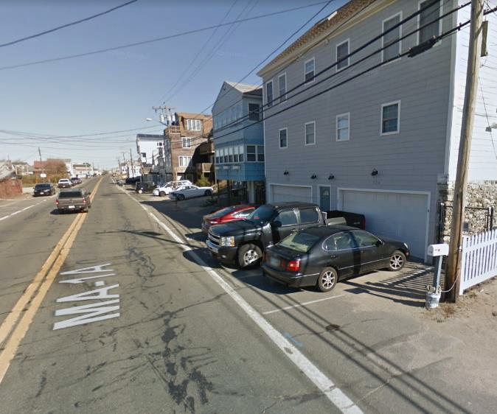
North End Boulevard Reconstruction
Salisbury, MA | 607710
Existing Issues (cont.)

Slide 10
North End Boulevard Reconstruction
Salisbury, MA | 607710
Project Goals
Intersection Safety | Improve Intersection Safety at Central Avenue
Roadway Safety | Improve Overall Roadway Safety.
Deficient Pedestrian Accommodation | Improve Pedestrian Accommodations.
Deficient Bike Accommodation | Improve Bicyclist Accommodations.
Minimize Right-of-Way Impacts
Drainage | Analyze Drainage System, Improve Drainage Runoff Control, Improve Drainage System Capacity

Slide 11
North End Boulevard Reconstruction
Salisbury, MA | 607710
Alternatives
Concept A – Bike Lanes
Concept B - Two-Way Separated Bike Lanes
Concept C - Shared Use Path

Slide 12
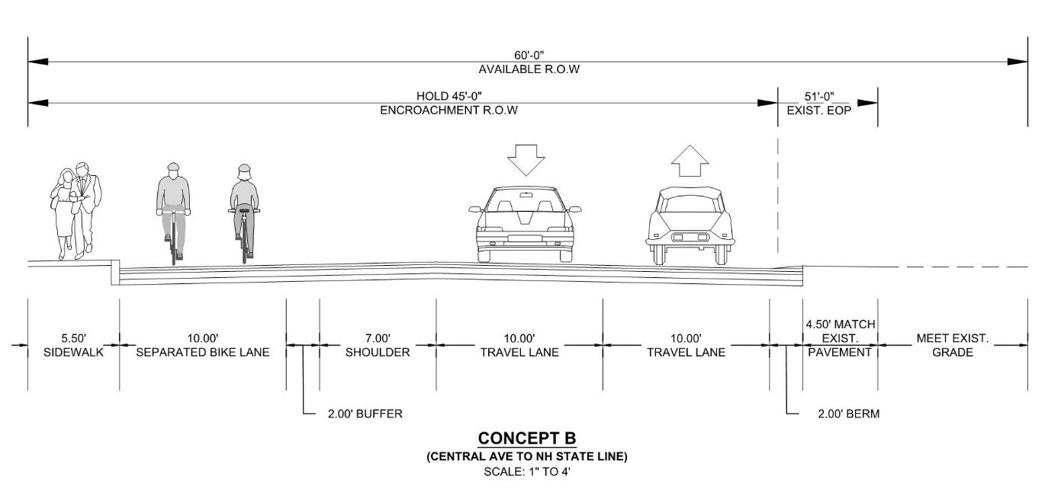
North End Boulevard Reconstruction
Salisbury, MA | 607710
Alternatives
Concept B - Two-Way Separated Bike Lanes
Notes:
Insert project name, location, file no.
Depending on complexity, may need to be multiple slides;

Slide 13
North End Boulevard Reconstruction
Salisbury, MA | 607710
Alternatives
Concept B - Two-Way Separated Bike Lanes
Notes:
Insert project name, location, file no.
Depending on complexity, may need to be multiple slides;

Slide 14
North End Boulevard Reconstruction
Salisbury, MA | 607710
Alternatives
Concept B - Two-Way Separated Bike Lanes
Notes:
Insert project name, location, file no.
Depending on complexity, may need to be multiple slides;

Slide 15
North End Boulevard Reconstruction
Salisbury, MA | 607710
Alternatives
Concept B - Two-Way Separated Bike Lanes
Notes:
Insert project name, location, file no.
Depending on complexity, may need to be multiple slides;

Slide 16
North End Boulevard Reconstruction
Salisbury, MA | 607710
Alternatives
Concept B - Two-Way Separated Bike Lanes
Notes:
Insert project name, location, file no.
Depending on complexity, may need to be multiple slides;

Slide 17
North End Boulevard Reconstruction
Salisbury, MA | 607710
Alternatives
Concept B - Two-Way Separated Bike Lanes
Notes:
Insert project name, location, file no.
Depending on complexity, may need to be multiple slides;

Slide 18
North End Boulevard Reconstruction
Salisbury, MA | 607710
Alternatives
Concept B - Two-Way Separated Bike Lanes
Notes:
Insert project name, location, file no.
Depending on complexity, may need to be multiple slides;

Slide 19
North End Boulevard Reconstruction
Salisbury, MA | 607710
Alternatives
Concept B - Two-Way Separated Bike Lanes
Notes:
Insert project name, location, file no.
Depending on complexity, may need to be multiple slides;

Slide 20
North End Boulevard Reconstruction
Salisbury, MA | 607710
Alternatives
Concept B - Two-Way Separated Bike Lanes
Notes:
Insert project name, location, file no.
Depending on complexity, may need to be multiple slides;

Slide 21
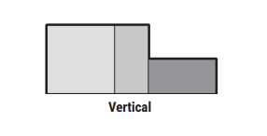
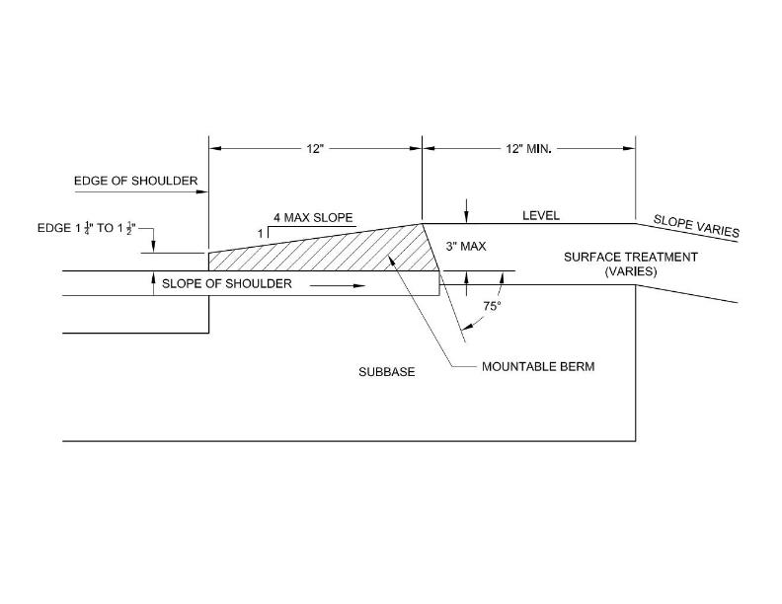
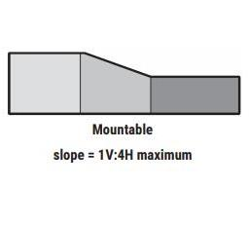
North End Boulevard Reconstruction
Salisbury, MA | 607710
Alternatives
Notes:
Insert project name, location, file no.
Depending on complexity, may need to be multiple slides;

Slide 22
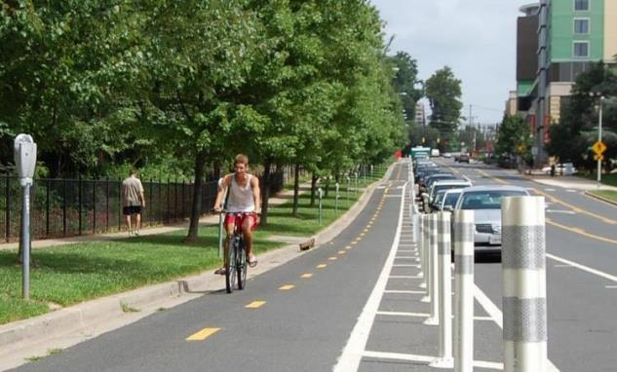
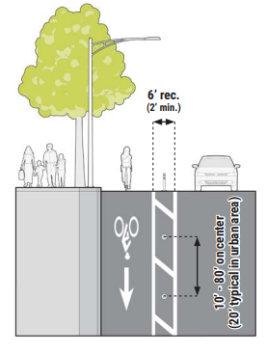
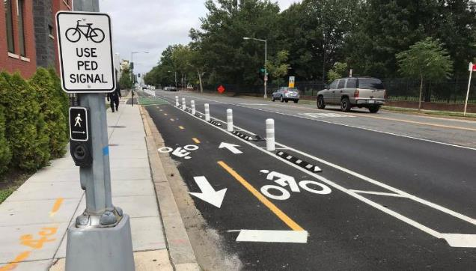
North End Boulevard Reconstruction
Salisbury, MA | 607710
Alternatives
Notes:
Insert project name, location, file no.
Depending on complexity, may need to be multiple slides;

Slide 23
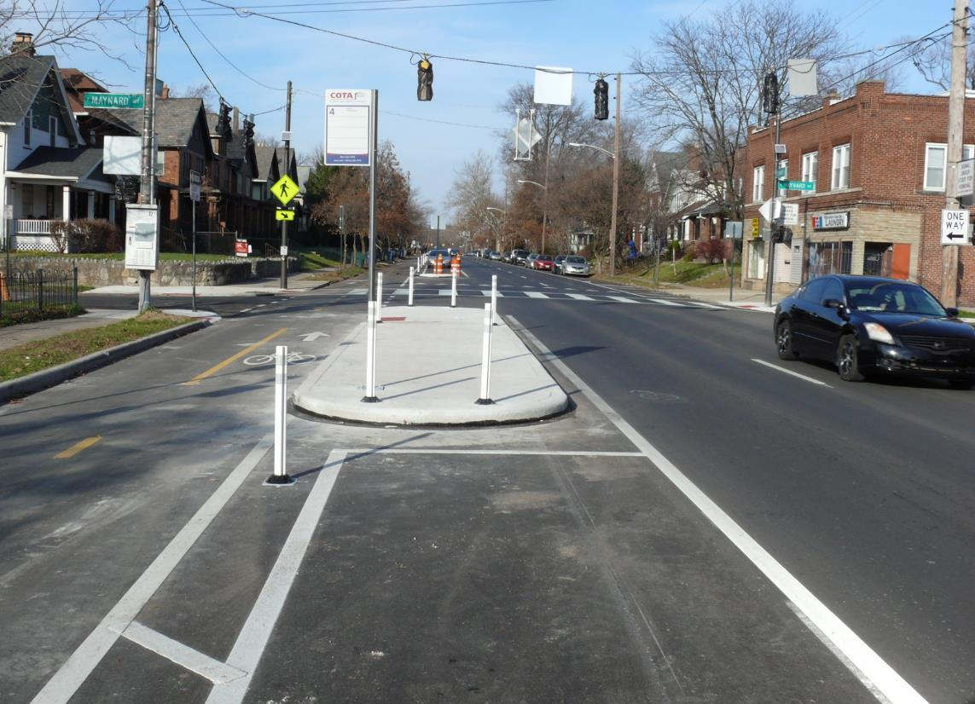
North End Boulevard Reconstruction
Salisbury, MA | 607710
Alternatives
Notes:
Insert project name, location, file no.
Depending on complexity, may need to be multiple slides;

Slide 24
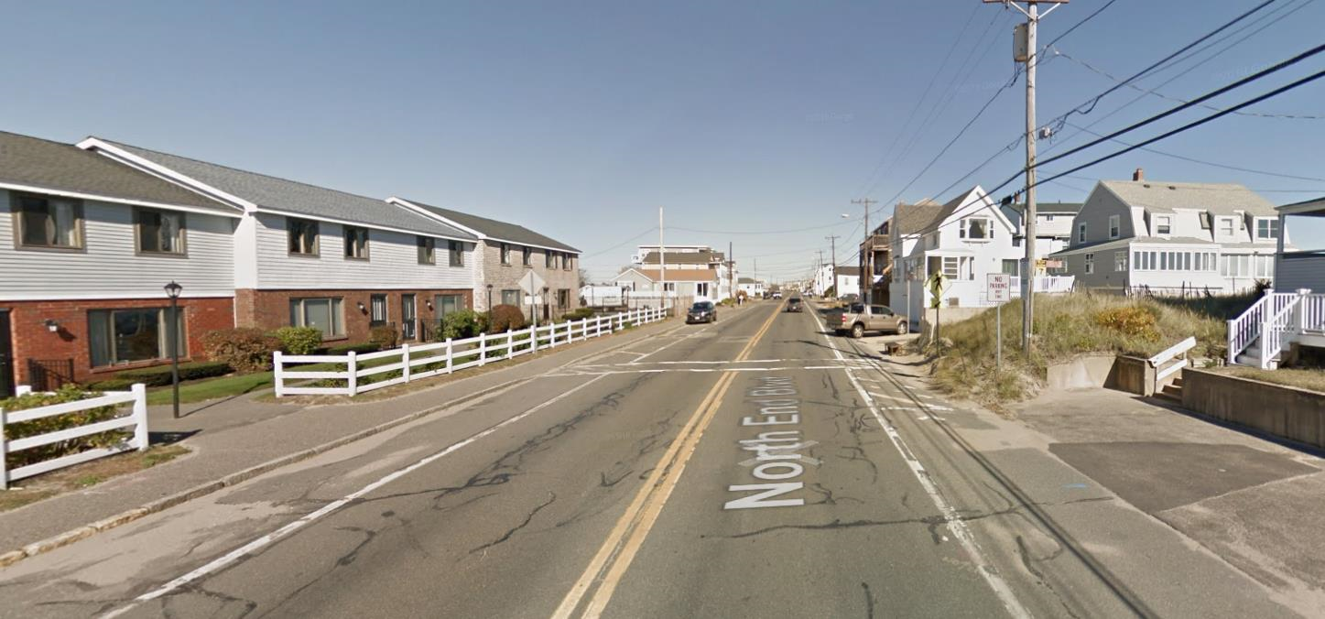
North End Boulevard Reconstruction
Salisbury, MA | 607710
Alternatives
Concept B – Two-Way Separated Bike Lanes
Notes:
Insert project name, location, file no.
Depending on complexity, may need to be multiple slides;

Slide 25
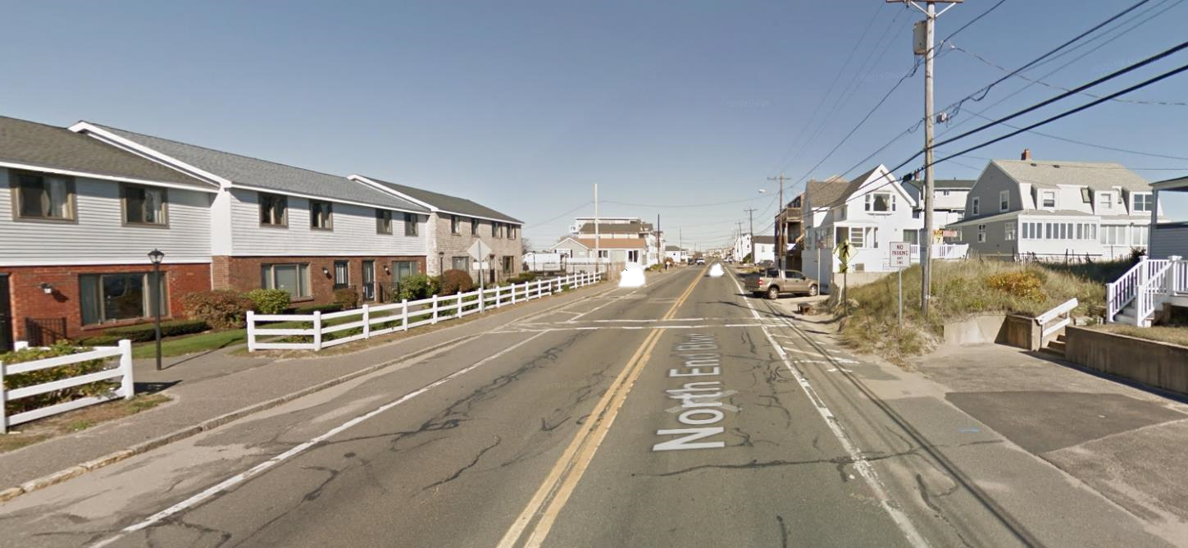
North End Boulevard Reconstruction
Salisbury, MA | 607710
Alternatives
Concept B – Two-Way Separated Bike Lanes
Notes:
Insert project name, location, file no.
Depending on complexity, may need to be multiple slides;

Slide 26
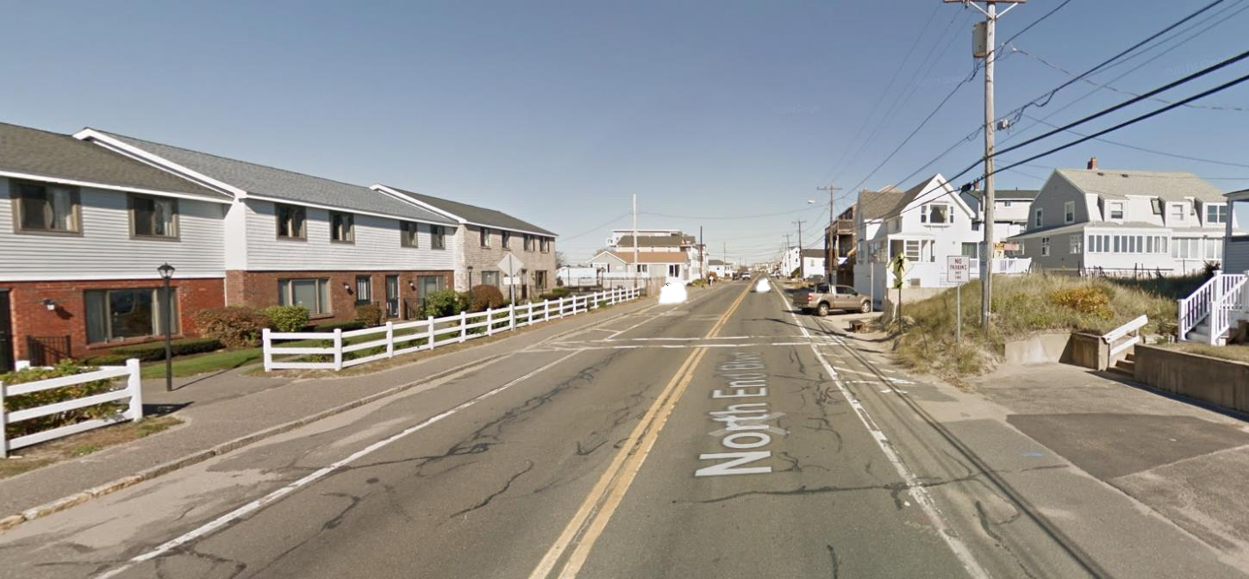
North End Boulevard Reconstruction
Salisbury, MA | 607710
Alternatives
Concept B – Two-Way Separated Bike Lanes
Notes:
Insert project name, location, file no.
Depending on complexity, may need to be multiple slides;

Slide 27
North End Boulevard Reconstruction
Salisbury, MA | 607710
Alternatives
Concept B – Two-Way Separated Bike Lanes
Notes:
Insert project name, location, file no.
Depending on complexity, may need to be multiple slides;

Slide 28
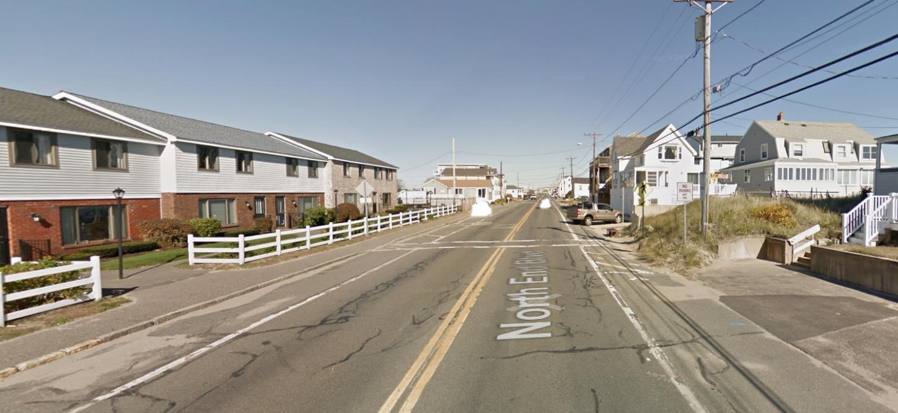
North End Boulevard Reconstruction
Salisbury, MA | 607710
Alternatives
Concept B – Two-Way Separated Bike Lanes
Notes:
Insert project name, location, file no.
Depending on complexity, may need to be multiple slides;

Slide 29
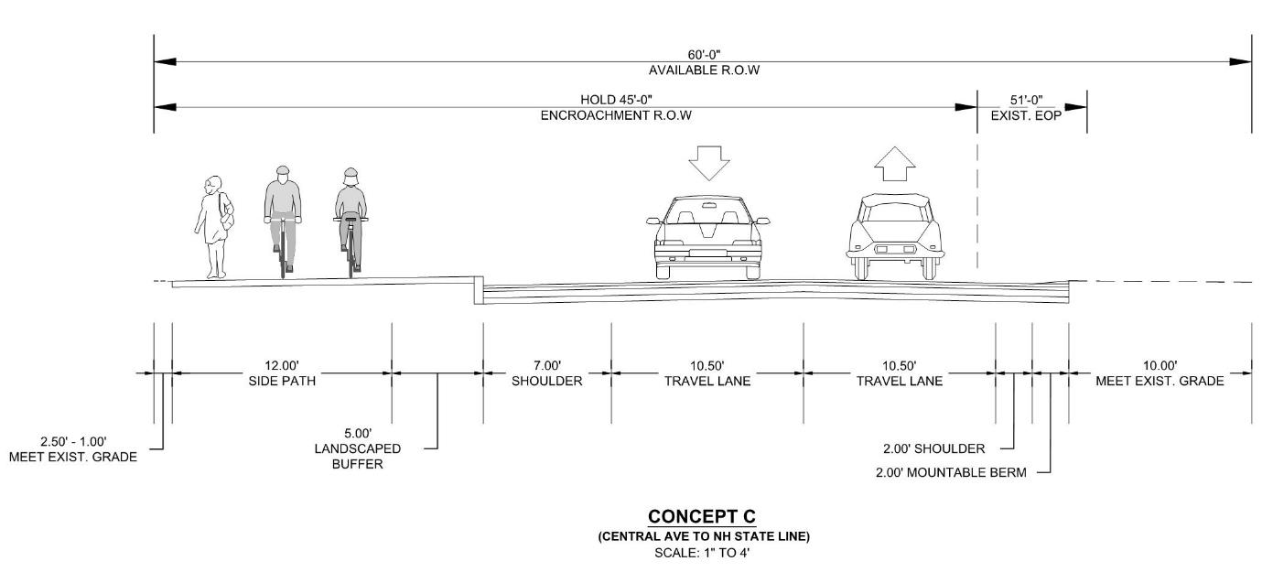
North End Boulevard Reconstruction
Salisbury, MA | 607710
Alternatives
Concept C - Shared Use Path
Notes:
Insert project name, location, file no.
Depending on complexity, may need to be multiple slides;

Slide 30
North End Boulevard Reconstruction
Salisbury, MA | 607710
Alternatives
Concept C - Shared Use Path
Notes:
Insert project name, location, file no.
Depending on complexity, may need to be multiple slides;

Slide 31
North End Boulevard Reconstruction
Salisbury, MA | 607710
Alternatives
Concept C - Shared Use Path
Notes:
Insert project name, location, file no.
Depending on complexity, may need to be multiple slides;

Slide 32
North End Boulevard Reconstruction
Salisbury, MA | 607710
Alternatives
Concept C - Shared Use Path
Notes:
Insert project name, location, file no.
Depending on complexity, may need to be multiple slides;

Slide 33
North End Boulevard Reconstruction
Salisbury, MA | 607710
Alternatives
Concept C - Shared Use Path
Notes:
Insert project name, location, file no.
Depending on complexity, may need to be multiple slides;

Slide 34
North End Boulevard Reconstruction
Salisbury, MA | 607710
Alternatives
Concept C - Shared Use Path
Notes:
Insert project name, location, file no.
Depending on complexity, may need to be multiple slides;

Slide 35
North End Boulevard Reconstruction
Salisbury, MA | 607710
Alternatives
Concept C - Shared Use Path
Notes:
Insert project name, location, file no.
Depending on complexity, may need to be multiple slides;

Slide 36
North End Boulevard Reconstruction
Salisbury, MA | 607710
Alternatives
Concept C - Shared Use Path
Notes:
Insert project name, location, file no.
Depending on complexity, may need to be multiple slides;

Slide 37
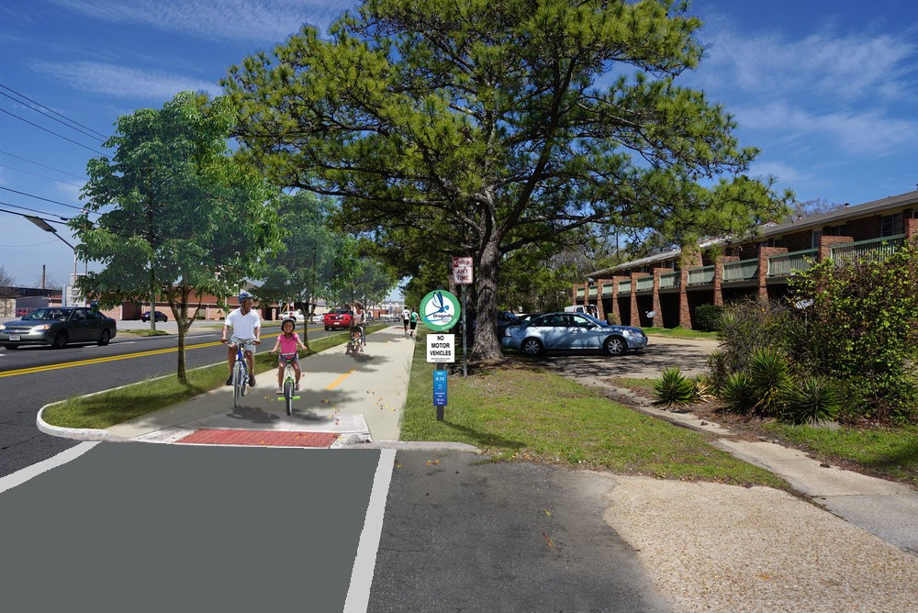
North End Boulevard Reconstruction
Salisbury, MA | 607710
Alternatives
Notes:
Insert project name, location, file no.
Depending on complexity, may need to be multiple slides;

Slide 38
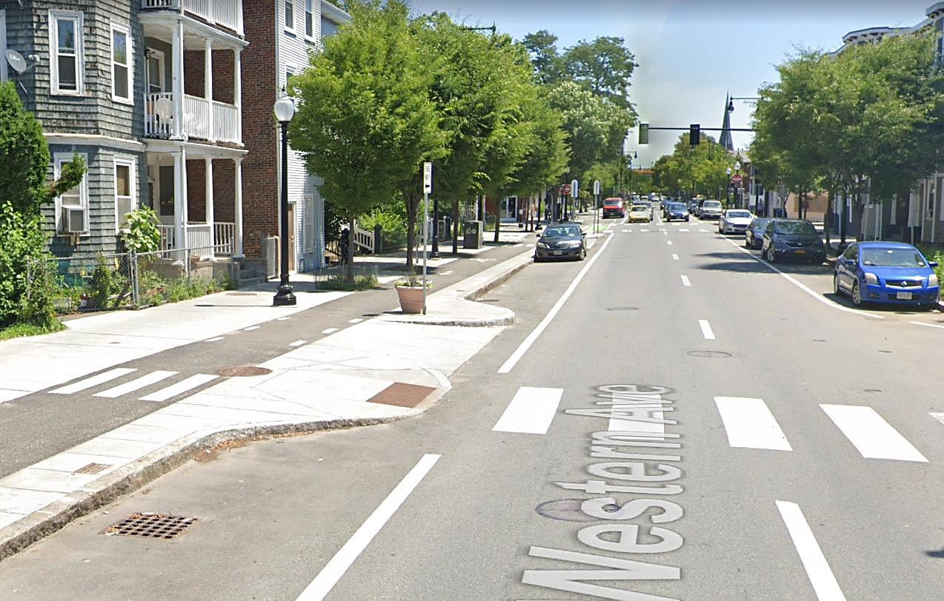
North End Boulevard Reconstruction
Salisbury, MA | 607710
Alternatives
Notes:
Insert project name, location, file no.
Depending on complexity, may need to be multiple slides;

Slide 39
North End Boulevard Reconstruction
Salisbury, MA | 607710
Alternatives
Concept C – Shared Use Path
Notes:
Insert project name, location, file no.
Depending on complexity, may need to be multiple slides;

Slide 40
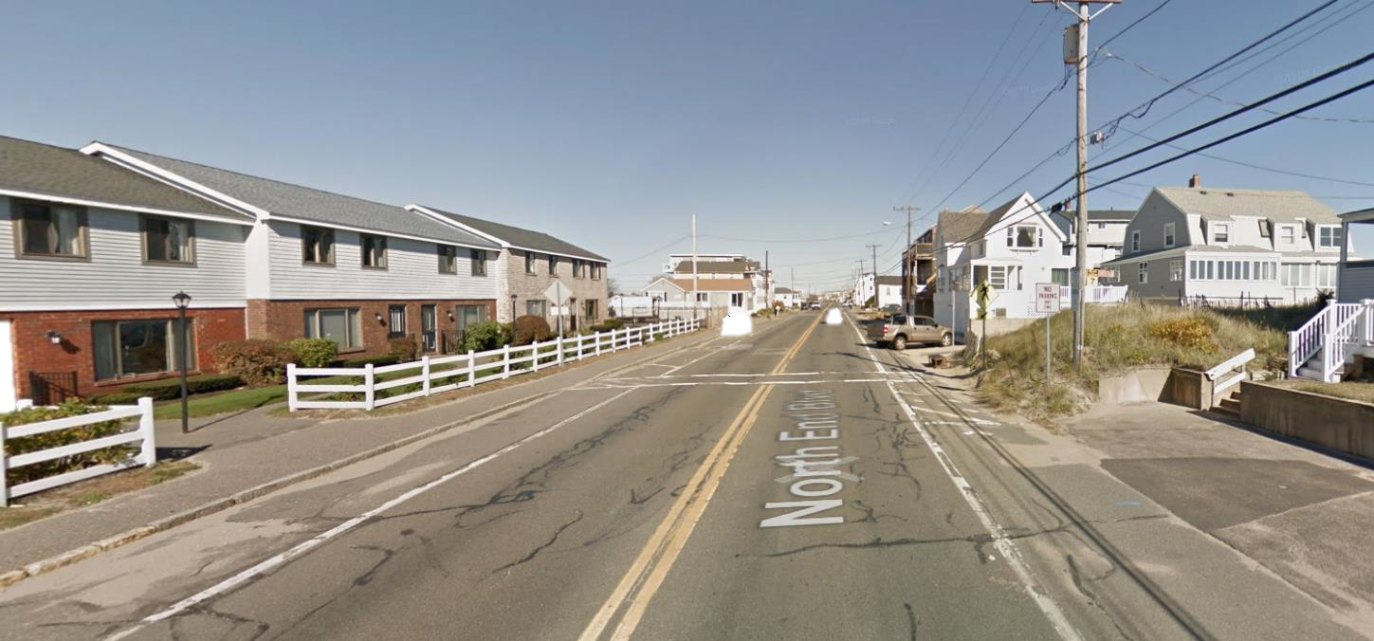
North End Boulevard Reconstruction
Salisbury, MA | 607710
Alternatives
Concept C – Shared Use Path
Notes:
Insert project name, location, file no.
Depending on complexity, may need to be multiple slides;

Slide 41
North End Boulevard Reconstruction
Salisbury, MA | 607710
Alternatives
Concept C – Shared Use Path
Notes:
Insert project name, location, file no.
Depending on complexity, may need to be multiple slides;

Slide 42
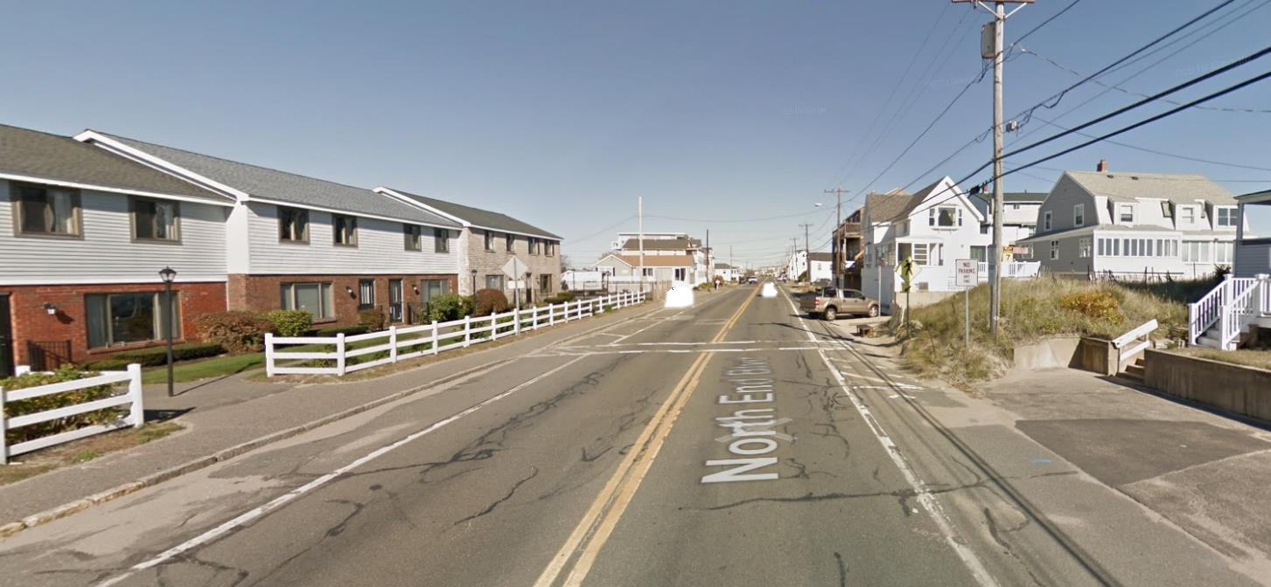
North End Boulevard Reconstruction
Salisbury, MA | 607710
Alternatives
Concept C – Shared Use Path
Notes:
Insert project name, location, file no.
Depending on complexity, may need to be multiple slides;

Slide 43
North End Boulevard Reconstruction
Salisbury, MA | 607710
Alternatives
Concept C – Shared Use Path
Notes:
Insert project name, location, file no.
Depending on complexity, may need to be multiple slides;

Slide 44
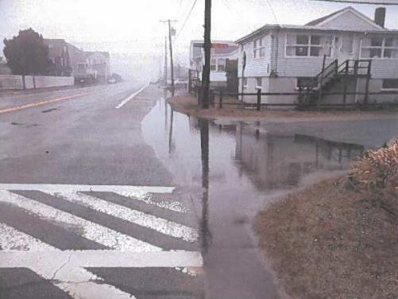
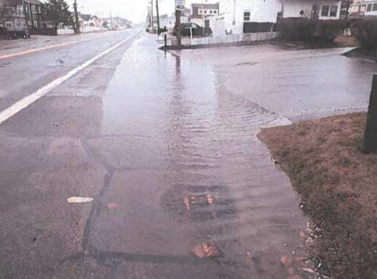
North End Boulevard Reconstruction
Salisbury, MA | 607710
Drainage Issues
Rainwater Surface Ponding |
Poorly Graded Roadway
Lack of Runoff Control
Lack of Drainage Structures
Undersized Drainage System |
Undersized for Larger; More Intense Rainfall Events
Tidal Impacts
System Maintenance |
Sediment Buildup in Structures and Pipes
Buried Outfalls
Notes:
To meet these goals, we have developed three concepts.

Slide 45
North End Boulevard Reconstruction
Salisbury, MA | 607710
Drainage Recommendations
Reduce Surface Ponding |
Provide Improved Edge Control
Regrade Roadway
Increase Number of Catch Basins
Improve Drainage System Capacity |
Increase System Pipe Sizes
Improve Pipe Slopes
Install Tidal/Flap Gates at Outfalls
System Maintenance |
Provide More Routine System Maintenance
Re-Establish Proper Outfall Conditions
Notes:
To meet these goals, we have developed three concepts.

Slide 46
Next Steps/Meeting
North End Boulevard Reconstruction
Salisbury, MA | 607710
.
Selection of Preferred Alternative |
Development of 25% Design Documents
Preform Right-of-Way Assessment |
Evaluate Impacts
Determine if Takings or Easements are Needed
Notes:
Insert project name, location, file no.
List the next meeting info

Slide 47
North End Boulevard Reconstruction
Salisbury, MA | 607710
Contact Information
Written Statement and Other Exhibits:
Mail-in:
Patricia A. Leavenworth, P.E., Chief Engineer
MassDOT
10 Park Plaza, Boston, MA 02116
Attention: Project Management, Project File No. 607710
Emailed to dot.feedback.highway@state.ma.us
Subject Line: Project Management, Project File No. 607710
Statements and Exhibits for Inclusion in the Public Meeting Transcript must be postmarked no later than 10 business days after the Public Meeting
Notes:
Insert project name, location, file no.
Provide contact information

Slide 48
Thank You Q&A
North End Boulevard (Route 1A) Reconstruction
Salisbury, MA | 607710
PUBLIC MEETING
SALISBURY, MA
NOVEMBER 19| 7:00PM

