Slide 1
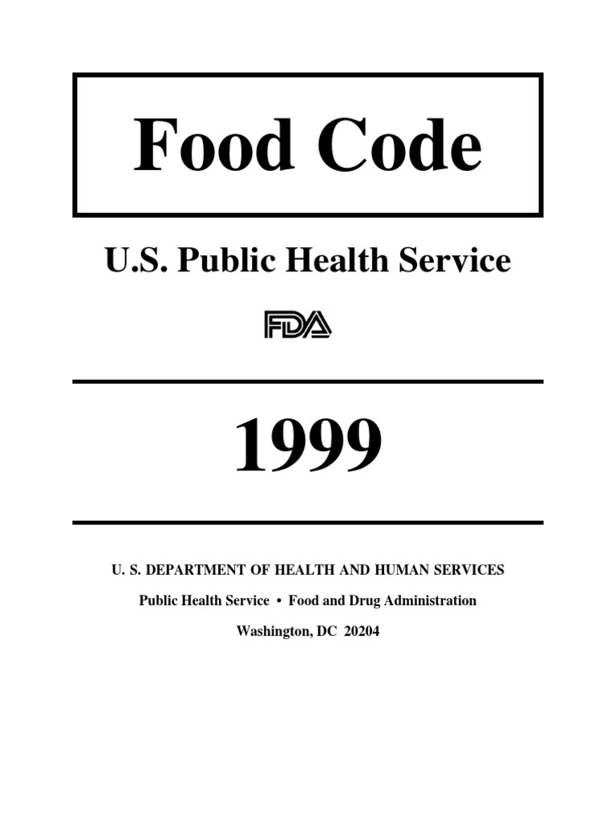
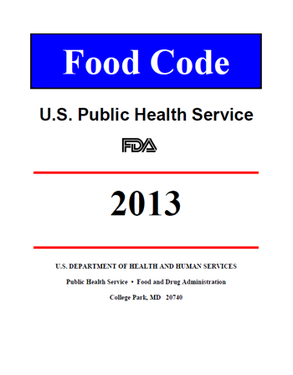
Food Code Changes
1999 to 2013
© Copyright 2018. Relavent Systems, Inc. All Rights Reserved. Proprietary and Confidential.

Slide 2
Food Code: Key Changes
Potentially Hazardous Foods
(PHF’s)
Time/Temperature Control for Safety Food
(TCS)
Added:
Cut leafy greens / Sliced Tomatoes
© Copyright 2018. BFSC Inc. All Rights Reserved. Proprietary and Confidential.
Notes:
There is a large section in the definitions of the food code (beginning page 22) describing other ways to assess whether or not a food is a TCS food. Have handout on this.

Slide 3
Red Critical
Black/Blue Critical
Non-Critical
Priority
Priority Foundation
Core
© Copyright 2018. BFSC Inc. All Rights Reserved. Proprietary and Confidential.

Slide 4
Food Code: Key Changes
PRIORITY ITEM “contributes directly to the elimination, prevention or reduction to an acceptable level, hazards associated with foodborne illness or injury and there is no other provision that more directly controls the hazard”
PRIORITY FOUNDATION ITEM “supports, facilitates or enables one or more PRIORITY ITEMS)
CORE ITEM “relates to general sanitation, operational controls, sanitation standard operating procedures (SSOPs), facilities or structures, equipment design, or general maintenance”
© Copyright 2018. BFSC Inc. All Rights Reserved. Proprietary and Confidential.

Slide 5
Food Code: Key Changes
Priority (P)
2-301.12 Cleaning Procedure
Observation – Employees not washing hands properly
Priority Foundation (Pf)
6.301.11 Handwashing Cleanser, Availability
Observation – No soap available at the handwashing sink.
Core (C)
6-301.14 Handwashing Signage
Observation – There was no sign indicating that employees must wash their hands.
© Copyright 2018. BFSC Inc. All Rights Reserved. Proprietary and Confidential.

Slide 6
Food Code: Key Changes
The New Inspection Report
© Copyright 2018. BFSC Inc. All Rights Reserved. Proprietary and Confidential.

Slide 10
Food Code: Key Changes
The New Inspection Report
IN = in compliance
OUT = out of compliance
N/O = not observed
N/A = not applicable
COS = corrected on-site during inspection
R = repeat violation
© Copyright 2018. BFSC Inc. All Rights Reserved. Proprietary and Confidential.

Slide 11
Food Code: Key Changes
Time Frame for Corrections
PRIORITY ITEM & PRIORITY FOUNDATION ITEM – must be corrected immediately.
Depending on the nature of the hazard and the complexity of the corrective action needed, extra time may be granted provided that:
PRIORITY ITEM’s are corrected in no more than 72 hours
Priority Foundation Items are corrected in no more than 10 days.
PRIORITY FOUNDATION ITEM’s are corrected in no more than 90 days
© Copyright 2018. BFSC Inc. All Rights Reserved. Proprietary and Confidential.

Slide 12
Food Code: Key Changes
New Employee Health
and Hygiene Requirements
When to wash – Food Code Added, “Before donning gloves . . . Must wash hands.” (FC 2-301.14)
How to wash – “Rub vigorously for at least 10-15 seconds” . . . and “Dry thoroughly” (FC 2-301.12)
PIC must train employees in food allergy awareness
(FC 2-103.11 / 590.002(D))
© Copyright 2018. BFSC Inc. All Rights Reserved. Proprietary and Confidential.

Slide 13
Food Code: Key Changes
New Employee Health
and Hygiene Requirements
Procedures are required for employees to follow when responding to vomiting and diarrheal events. (FC 2-501.11)
Employees must report to the PIC information about their health and activities as they relate to diseases transmissible through food. (Can use the Food Employee Reporting Agreement) (FC 2-201.11 / 590.002(E)
© Copyright 2018. BFSC Inc. All Rights Reserved. Proprietary and Confidential.

Slide 14
Food Code: Key Changes
Changes in Exclusions
A diagnoses of Norovirus – a food hander may return to work 72 hours after symptoms resolved – not 48 hours. (FC 2-201.11)
© Copyright 2018. BFSC Inc. All Rights Reserved. Proprietary and Confidential.

Slide 15
Food Code: Key Changes
Receiving hot foods - now 135°F (FC 3-202.11)
Hot Holding – now 135°F (FC 3-501.16)
Cooling - now 135°F to 70°F in 2 hours then 70°F to 41°F in 4 hours (FC 3-501.14)
© Copyright 2018. BFSC Inc. All Rights Reserved. Proprietary and Confidential.

Slide 16
Food Code: Key Changes
In-use utensil – may now be stored in hot water at 135°F or higher (FC 3-304.12)
Reheating commercially processed TCS foods must now be reheated to 135°F (FC 3-403.11)
Cooking fruits and vegetables for hot holding - now 135°F (FC 3-401.13)
© Copyright 2018. BFSC Inc. All Rights Reserved. Proprietary and Confidential.

Slide 17
Food Code: Key Changes
New Cooking Regulations
Non-Continuous Cooking (Par-cooking / Grill Marking) of raw animal foods:
(FC 3-401.14)
Initial process may not exceed 60 minutes
Product must be cooled properly
Product must be stored properly (41°For below or frozen and as its still raw, stored to prevent cross)
Product must be cooked to “normal” cooking temperature
Have prior approval by regulatory authority and written procedures that:
  Are maintained on file,
  Describe how the above items are to be monitored,
  Describe how these are marked or identified as items that must be cooked, and
  Describe how these are separated from RTE foods.
© Copyright 2018. BFSC Inc. All Rights Reserved. Proprietary and Confidential.

Slide 18
Food Code: Key Changes
New Cooking Regulations
Children’s Menus may not offer hamburgers
cooked to order – they must be fully cooked. (FC 3-401.11)
© Copyright 2018. BFSC Inc. All Rights Reserved. Proprietary and Confidential.

Slide 19
Food Code: Key Changes
New Thawing Regulations
Reduced Oxygen Packaging Fish
Must be removed from packaging immediately before thawing in a refrigerator
Or
Immediately before or after thawing under cold running water.
(FC 3-501.13)
© Copyright 2018. BFSC Inc. All Rights Reserved. Proprietary and Confidential.

Slide 20
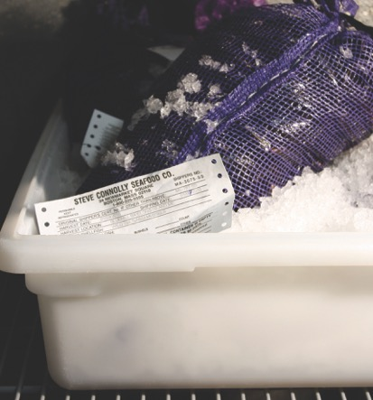
Food Code: Key Changes
Other New Regulations
Shellstock Tags (FC 3-203.12)
Shellstock tags must be maintained for 90 days;
Kept in chronological order; and the
Date recorded for the last day in which the last piece was served.
© Copyright 2018. BFSC Inc. All Rights Reserved. Proprietary and Confidential.
Notes:
90 day clock starts at the time the container of shellstock is emptied.
The 90 days is based on the considerations for Hep A (14 day shelf life, 56 day incubation perios; 5 days for diagnosis; 5 days for reporting and 10 days for epidemiological confirmation.

Slide 21
Food Code: Key Changes
Other New Regulations
Refilling Returnables (FC 3-304.17)
The materials being refilled must be safe and durable under normal conditions.
They must have been provided by the establishment to the consumer for the purpose of being reused.
They must be returned to the food establishment by the customer after use.
They must be cleaned, sanitized and visually inspected by the employee to assure all of the above.
© Copyright 2018. BFSC Inc. All Rights Reserved. Proprietary and Confidential.
Notes:
90 day clock starts at the time the container of shellstock is emptied.
The 90 days is based on the considerations for Hep A (14 day shelf life, 56 day incubation perios; 5 days for diagnosis; 5 days for reporting and 10 days for epidemiological confirmation.

Slide 22
Food Code: Key Changes
Other New Regulations
TPHC
If time rather than temperature is used as a public health control for TCS foods:
Cold food may remain out of temperature control for up to 6 hours providing that the product temperature does not exceed 70°F.
If food is above 70°F, only 4 hours is allowed out of temperature control. (This has not changed).
Hot food may remain out of temperature control for up to 4 hours. (This has not changed). (FC 3-501.19)
In MA, written procedures must be prepared in advance, submitted to the RA for review, maintained in the establishment and made available to the RA. No variance is required. . (590.003(D)
© Copyright 2018. BFSC Inc. All Rights Reserved. Proprietary and Confidential.

Slide 23
Food Code: Key Changes
Other New Regulations
Date-Marking (FC 3-501.17)
All TCS – RTE foods prepared in an establishment that will be held in a refrigerator for more than 24 hours must be date-marked with the date in which the product is to be consumed or discarded.
The date must be 7 days from the day in which it was prepared with the day of preparation counting as day one.
All TCS – RTE foods prepared and packaged by a food processing plant shall be date-marked the time in which the container was opened and, if held in a refrigerator for more than 24 hours, must be date-marked with the date in which the product is to be consumed or discarded.
The date must be 7 days from the day in which the container was opened with the day of opening counting as day one. This date may not exceed the manufacturers pull date.
© Copyright 2018. BFSC Inc. All Rights Reserved. Proprietary and Confidential.

Slide 24
Food Code: Key Changes
Other New Regulations
Date-Marking
Is NOT needed for:
Deli Salads Prepared and Packaged in a Food Processing Plant (these contain sufficient acidity to prevent Listeria growth)
Hard and Semi-Soft Cheese (Semi-soft includes cheese such as havarti, Monterey Jack, Muenster; hard cheese includes cheddar, gouda, parmesan, etc. . .)
Cultured Dairy Products (yogurt, sour cream and buttermilk)
Preserved fish products (pickled herring and dried or salted cod)
Shellstock
Shelf-stable RTE meat and poultry products
© Copyright 2018. BFSC Inc. All Rights Reserved. Proprietary and Confidential.

Slide 25
Food Code: Key Changes
Other New Regulations
Packaging Juice at Retail – Label Requirements
(FC 3-404.11)
“WARNING: This product has not been pasteurized and, therefore, may contain harmful bacteria that can cause serious illness in children, the elderly, and persons with weakened immune systems.”
© Copyright 2018. BFSC Inc. All Rights Reserved. Proprietary and Confidential.

Slide 26
Food Code: Key Changes
Other New Regulations
Labeling for Packaged Foods
(FC 3-601.11)
© Copyright 2018. BFSC Inc. All Rights Reserved. Proprietary and Confidential.

Slide 27
Food Code: Key Changes
Other New Regulations
Variance Required
Smoking Food (only as method of food preservation)
Curing Food
Using Food Additives (i.e. vinegar) as food preservation or to render food a non TCS food
ROP
Molluscan shellfish life-support system display tanks for consumption
Custom Processing of Animals
Preparing food by another method that is determined by RA to require a variance
Sprouting seeds – NEW!
© Copyright 2018. BFSC Inc. All Rights Reserved. Proprietary and Confidential.

Slide 28
Food Code: Key Changes
Additions
Reduced Oxygen Packaging (ROP)
(FC 3-502.12)
Listeria is now identified as a hazard for ROP
Added guidance for Sous Vide, Cook-Chill and Cheese
Can have up to 30 day extended shelf life for:
  Additional barrier – providing hurdle effect
  Sous Vide or Cook-Chill – cooled (after initial cooling) to 34°F in 48 hours and held at this temperature
No variance OR HACCP plan required if:
  Always labeled with production time & date
  Held at 41°For lower
  Removed from packaging within 48 hours.
© Copyright 2018. BFSC Inc. All Rights Reserved. Proprietary and Confidential.

Slide 29
Food Code: Key Changes
Additions
Parasite Destruction
(FC 3-402.11)
Raw, raw-marinated, partially cooked, or marinated-partially cooked FISH shall be:
Frozen and stored at a temperature of -4°F or below for a minimum of 7 days
Frozen at -31°F or below until solid and stored at -31°F or below for a minimum of 15 hours; or
Frozen at -31°F or below until solid and stored at -4°F or below for a minimum of 24 hours.
© Copyright 2018. BFSC Inc. All Rights Reserved. Proprietary and Confidential.

Slide 30
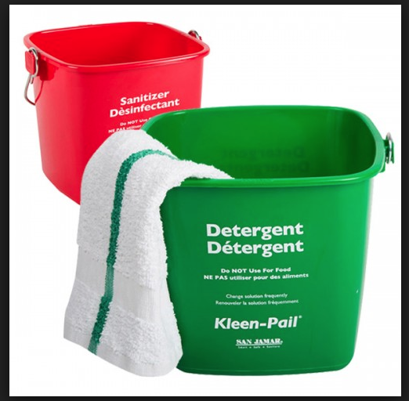
Food Code: Key Changes
New Cleaning and
Sanitizing Regulations
Cleaning and sanitizing agents must be available at all prep areas during preparation. (FC 4-303.11 Sup.)
Sanitizing buckets must be stored off the floor and in a manner that prevents contamination. . (FC 3-304.14)
© Copyright 2018. BFSC Inc. All Rights Reserved. Proprietary and Confidential.

Slide 31

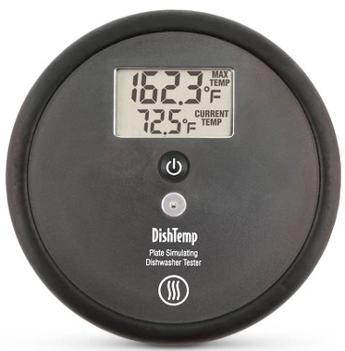
Food Code: Key Changes
New Cleaning and
Sanitizing Regulations
High-temp dish machines - an irreversible registering temperature indicator shall be provided and readily accessible for measuring the utensil surface temperature (surface temperature must be 160°F). (FC 4-302.13)
© Copyright 2018. BFSC Inc. All Rights Reserved. Proprietary and Confidential.
Notes:
Pressure in 1999 indicated must be 15-25psi. New code states follow manufactuer’s data plate instructions

Slide 32
Food Code: Key Changes
New Cleaning and
Sanitizing Regulations
Thermometers must be available at the three-bay sink to measure the temperature of the wash tank (110°F) and the sanitize tank. (FC 4-302.13)
© Copyright 2018. BFSC Inc. All Rights Reserved. Proprietary and Confidential.
Notes:
Pressure in 1999 indicated must be 15-25psi. New code states follow manufactuer’s data plate instructions

Slide 33
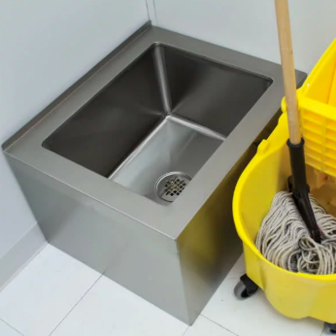
Food Code: Key Changes
New Cleaning and
Sanitizing Regulations
Mop sinks must be provided – waste water cannot be dumped in toilets or urinals. (FC 5-203.13)
© Copyright 2018. BFSC Inc. All Rights Reserved. Proprietary and Confidential.

Slide 34
Food Code: Key Changes
Other New Regulations
Controlling Pests (FC 6-501.111)
The premises must be maintained FREE of insects, rodents and other pests and shall be controlled to eliminate their presence on the premises by:
  Inspecting incoming shipments
  The premises for evidence of pests
  Use methods such as trapping devices for control
  Eliminate harborage condition.
© Copyright 2018. BFSC Inc. All Rights Reserved. Proprietary and Confidential.
Notes:
90 day clock starts at the time the container of shellstock is emptied.
The 90 days is based on the considerations for Hep A (14 day shelf life, 56 day incubation perios; 5 days for diagnosis; 5 days for reporting and 10 days for epidemiological confirmation.

Slide 35
Food Code: Key Changes
Change in Plumbing
Handwashing sink – Water Temps
A HANDWASHING SINK shall be equipped to provide water at a temperature of at least 100ºF) through a mixing valve or combination faucet. (FC 5-202.12)
© Copyright 2018. BFSC Inc. All Rights Reserved. Proprietary and Confidential.

Slide 36
Food Code: Key Changes
Change in Definitions
“Food Establishments” DON’T Include:
An establishment that offers only prepackaged foods that are not TCS foods
An operation that only offers whole, uncut fresh fruits and vegetables, unprocessed honey, pure maple products, or farm fresh eggs which are stored and maintained at 45°F (Includes a Temporary Food Establishment or Public Markets or Farmers Markets)
Cooking classes that are held for educational purposes only.
Pot luck events (people informed that neither food nor the facilities have been inspected by RA)
NO PERMIT NEEDED!
© Copyright 2018. BFSC Inc. All Rights Reserved. Proprietary and Confidential.

Slide 37
Food Code: Key Changes
Change in Definitions
“Cottage Food Operations” means:
A person who produces cottage food products only in the home kitchen of that person’s primary domestic residence and only for sale directly to the consumer.
Non-TCS baked goods, jams, jellies, and other non-TCS foods produced at a cottage food operation.
Must be approved and permitted by the LBOH
© Copyright 2018. BFSC Inc. All Rights Reserved. Proprietary and Confidential.

Slide 38
Food Code: Key Changes
Change in Definitions
“Bed and Breakfast” means:
An operation that prepares and offers food to guests if the home is owner occupied, the number of available guest bedrooms does not exceed 6, breakfast is the only meal offered, the number of guests served does not exceed 18, and the consumer is informed that the kitchen is not regulated or inspected by the regulatory authority.
© Copyright 2018. BFSC Inc. All Rights Reserved. Proprietary and Confidential.

Slide 39
Food Code: Key Changes
Permitting
“Leased Commercial Kitchen” are food preparation facilities that provide space and access to professional equipment on a lease or rental basis.
Required approvals:
The lessor of a leased Commercial Kitchen shall not rent or share the kitchen unless it has been approved to do so and has obtained a valid permit from the BOH. Is subject to inspections.
Each lessee must obtain a retail or wholesale food permit from the BOH.
© Copyright 2018. BFSC Inc. All Rights Reserved. Proprietary and Confidential.

Slide 40
Food Code: Key Changes
Other New Regulations
Posting the Inspection Report
Notify customers that a copy of the most recent establishment inspection report is available upon request by posting a sign or placard in a location in the food establishment that is conspicuous to customers or by another method acceptable to the REGULATORY AUTHORITY. (FC 8-304.11)
© Copyright 2018. BFSC Inc. All Rights Reserved. Proprietary and Confidential.

Slide 41
Food Code: Key Changes
State References
https://www.mass.gov/lists/massachusetts-retail-food-code#inspection-report-
© Copyright 2018. BFSC Inc. All Rights Reserved. Proprietary and Confidential.

